Slide 1
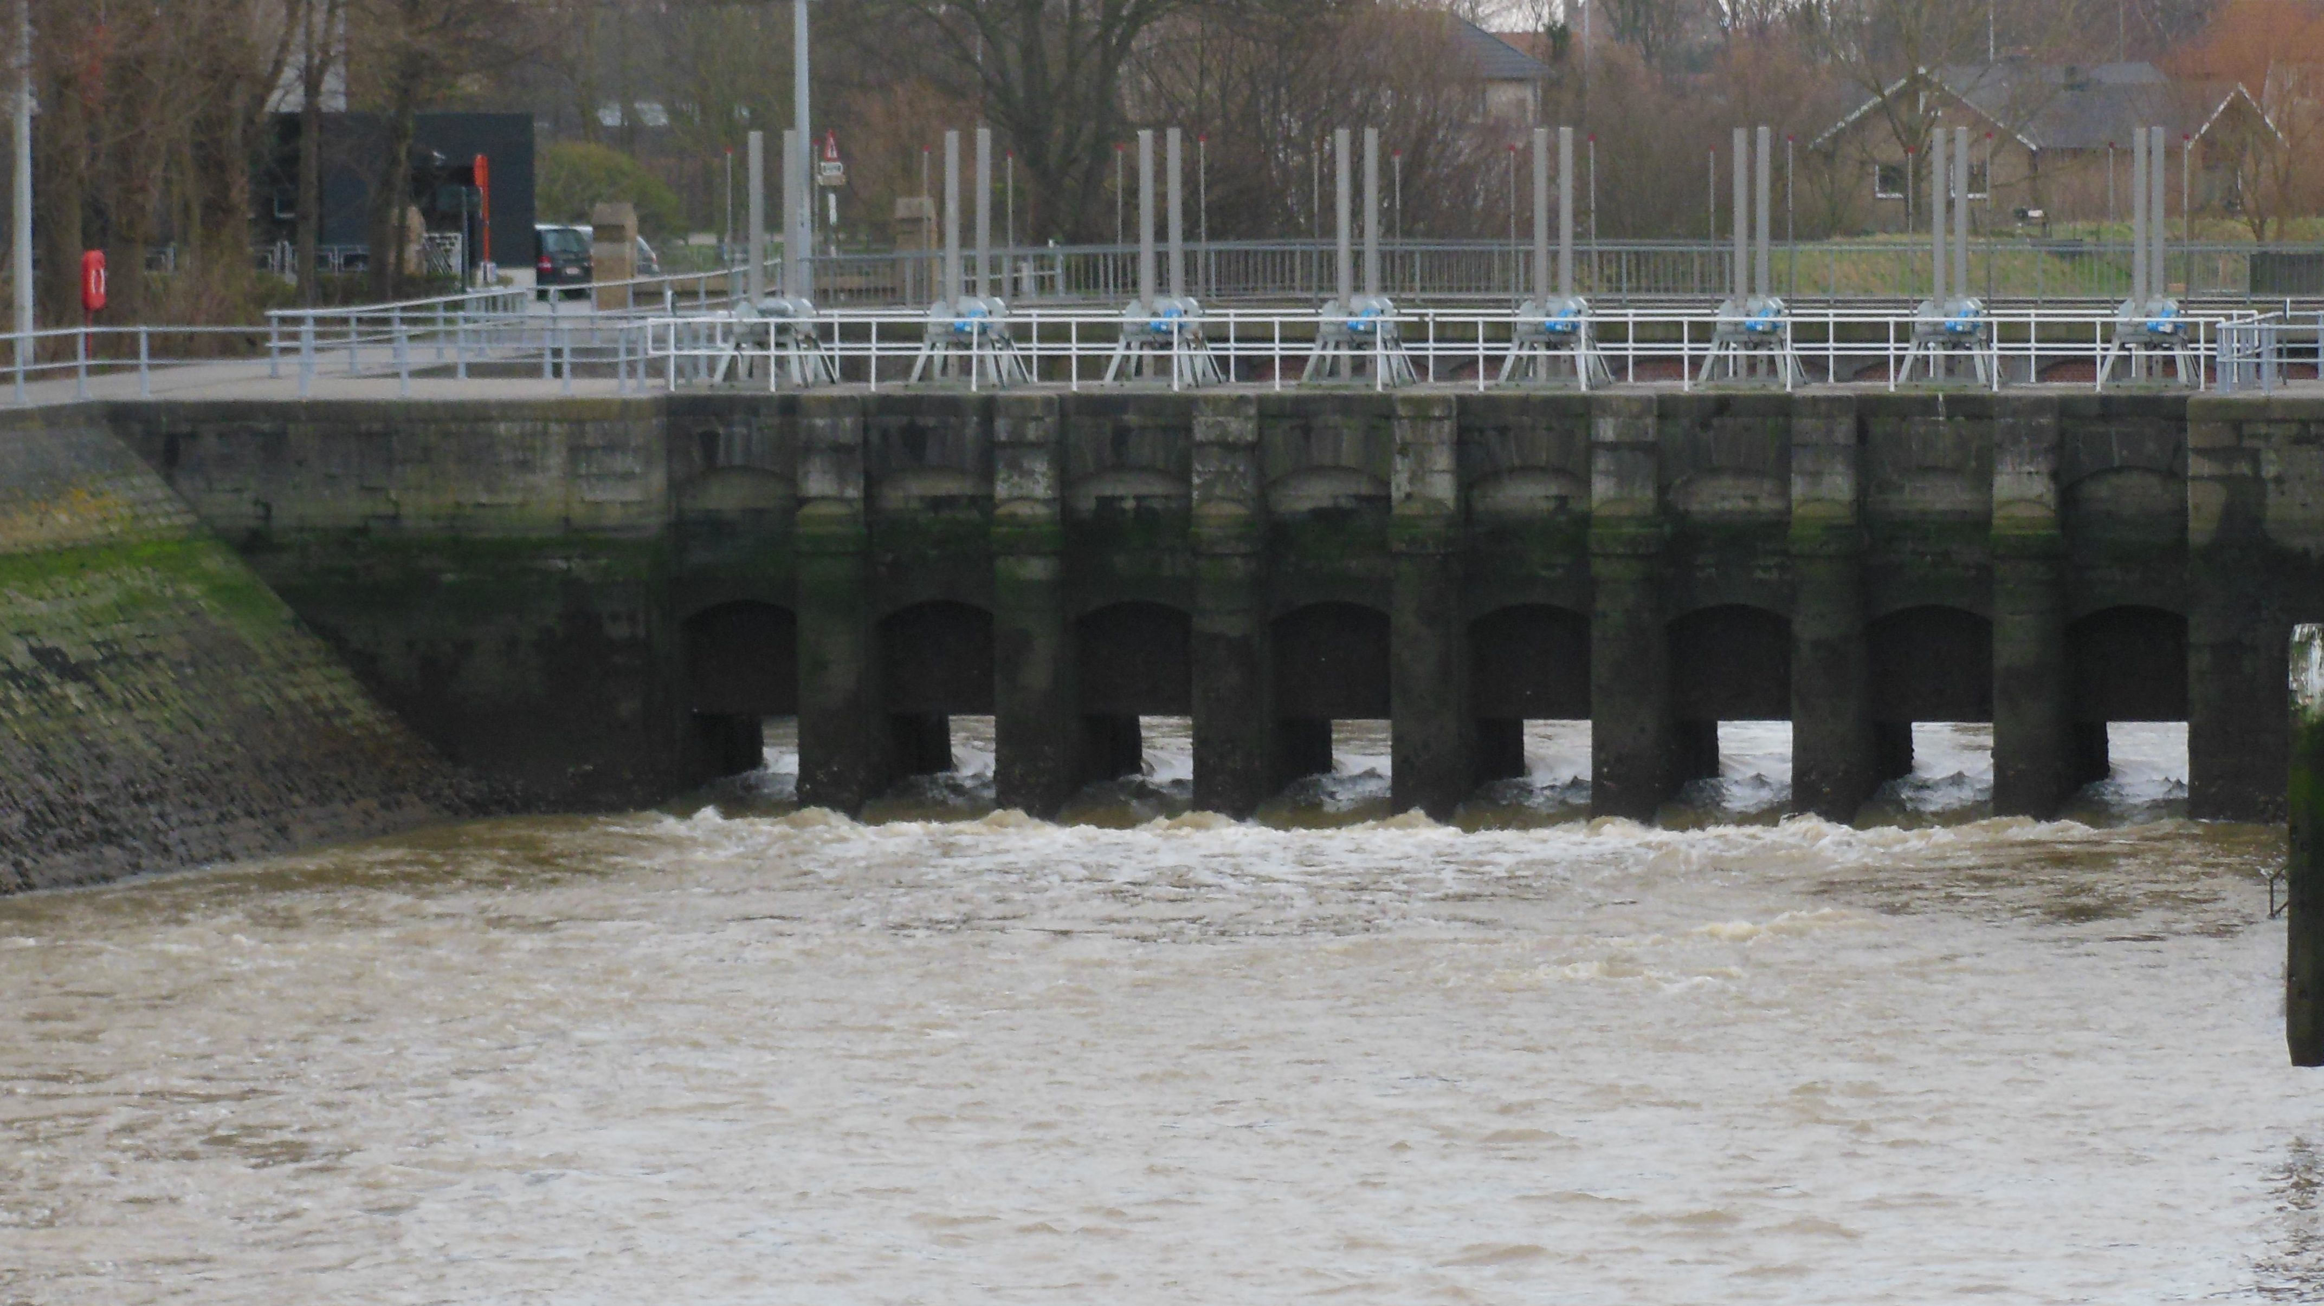



THE INFLUENCE OF ARTIFICIAL CANAL DYNAMICS ON EUROPEAN EEL RECRUITS
Master Biology Evolutionary Biology & Biodiversity
Supervisor: Dr. Pieterjan Verhelst
Promotors:
Prof. Dr. Marleen De Troch
Dr. Jeroen Van Wichelen
Michiel Perneel
Notes:
THESIS PRESENTATION
Clarity of the introduction
Hypotheses formulated
Methods and material clarified
Focus on important results
Discussion matches hypotheses
Scientific depth of discussion
Language use
Layout and style clear
Proper use of visual aids
Pace and number of slides, timing
QUESTIONING AND DISCUSSION WITH JURY
Focus of answers
Scientific background and depth
Clear and structured responses

Slide 2
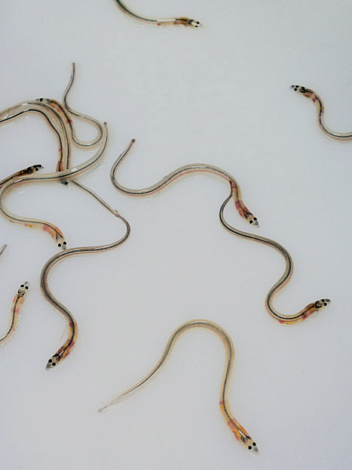
Content
Introduction
European eel – Life cycle
Natural habitat & current situation
Upstream migration: dynamics & drivers
Fatty acids & fish
Objectives
Materials & methods
Study area
Sampling methods
Artificial substrates
Lift nets
Glass eel ladders
Parameters & Statistical analysis
Results
Diet
Artificial Substrates
Eel ladder
Fatty acid analysis
Discussion & take-home message

Slide 3
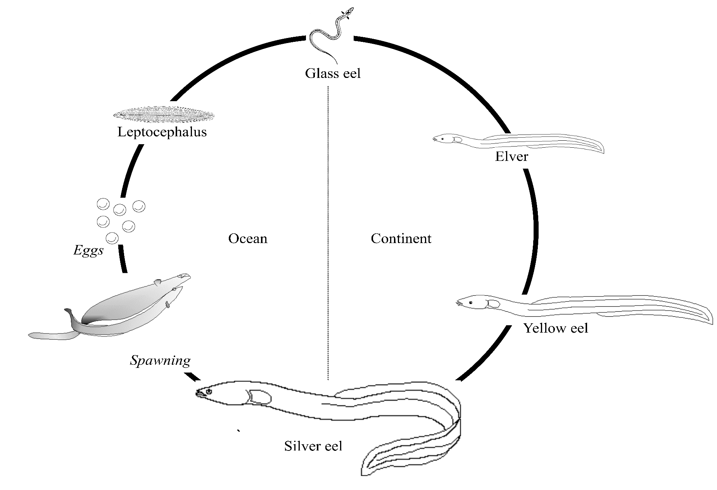
European eel – Life cycle
(Dekker, 2008)
Notes:
The European eel uses both marine and freshwater environments to complete its life history, and is therefore catadromous fish (Figure 1).
Eels are rightfully renowned for their endurance. Adult European eels spawn presumably in the Sargasso sea (central North Atlantic Ocean), yet never before have spawning adult eels nor eggs been observed in the wild (Schmidt, 1923).
From the eggs hatch willow leaf-shaped, translucent Atlantic larvae (leptocephalus larvae) which drift thousands of kilometres across open ocean, a journey estimated to last between 7 months and 2 years (Bonhommeau et al., 2010), to the continental shelf where they metamorphose into unpigmented glass eels. Hereby these juveniles are distributed across the entire continental shelf of the Atlantic coast of Europe and North Africa. These glass eels colonise coastal, estuarine and freshwater habitats (Harrison et al., 2014; van Ginneken & Maes, 2005). In these coastal, estuarine and freshwater habitats, the eels grow as yellow eels, which can take up to 3 to over 20 years, dependent on gender (on average 5.9 years for males and 8.7 years for females) and local environmental variables (Vollestad et al., 1986). Female mean size at maturity varies between 45 and 86 cm, whereas males have a mean length of 32-46cm (Vollestad et al., 1992). Hence a sexual dimorphism regarding size typifies the European eel. The eel is a fatty fish, presenting extremely high lipid contents (Tesch et al., 2003). These high lipid contents act as energy stores, essential for fulfilling their journey back to the spawning area. At the end of their growing phase, eels go through some morphological and physiological changes and become silver eels. Most silver eels of West-European populations leave their freshwater habitats in fall or early winter and head in the direction of the marine environment. In the open ocean they swim towards the Sargasso Sea, a journey of 5000 to 8000 km. During this voyage, gonadal development is continued and the eels fully mature. This migration could take between 6 months and 1,5 years (Righton et al., 2016), with a spawning peak presumably somewhere between March and June, ensuring the next generation of European eels which are the onset of a new cycle (van Ginneken & Maes, 2005).

Slide 4
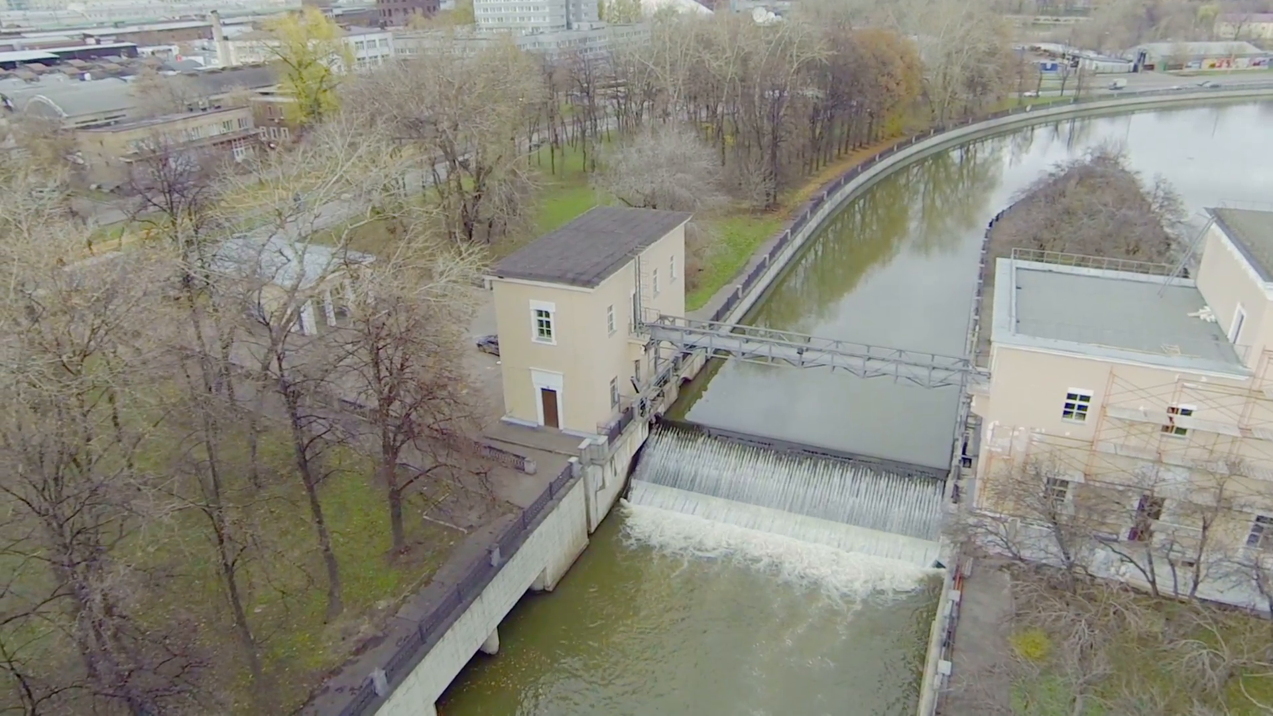
Natural habitat & current situation
Connected from source to mouth
Europe: 218 (>100km)
gentle gradient in salinity, other chemicals & physicochemistry
Far inland reaching tide
Flood plains, flat banks with structural vegetation
Connectivity lost
Europe: 223 (>100km), ± 1 million dams
Fluctuating salinity & physicochemical concentrations
Marginal tidal influence
Vertical canal walls
Notes:
In their ancient pristine habitat, glass eel use the far inland-reaching tides, salinity and other chemical gradients, flood plains and flat banks structured with vegetation for their inland migration. As of today, they encounter very different conditions in these canals: heavily fluctuating salinity concentrations, vertical canal walls, temperature fluctuations, a marginal tidal influence etc. So far, it is unknown how glass eels behave in these artificial systems in terms of migration capacity and feeding behaviour and how this is reflected in their condition.

Slide 5
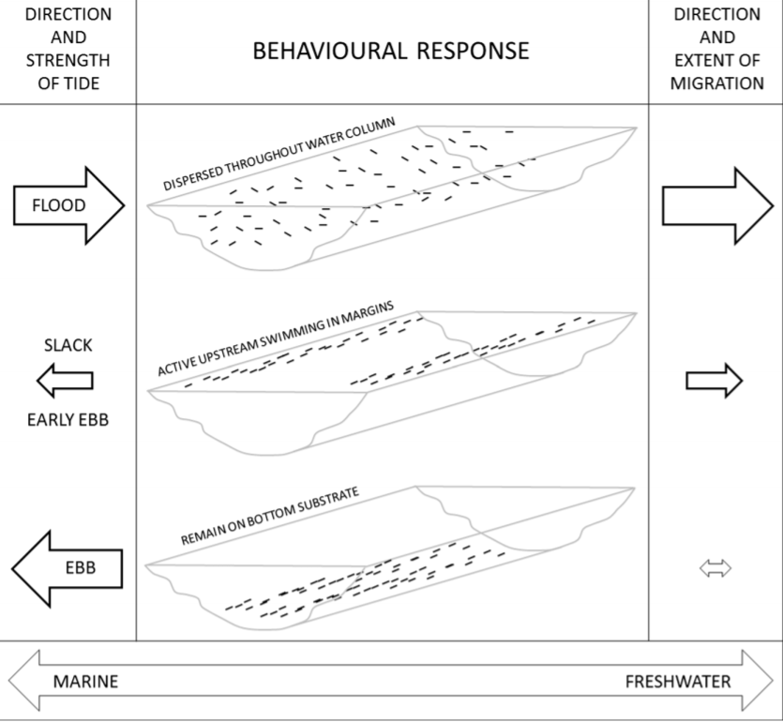
Upstream migration: dynamics & drivers
Selective tidal stream transport
Cues
Temperature
Salinity gradient (early)
Odour (late)
Early settlers would have a decreased body condition compared to active migrants
Habitat selection
Trade-off between growth, survival, competition avoidance and energetic cost of migration
(Harrisson, 2014)
Notes:
The far inland reaching tidal cycle mentioned in the previous slide is what these glass eel use to migrate upstream. During flood they swim effortlessly with the tides further upstream, and with the ebb tide they hide in holes and nooks to rest. This current use is called selective tidal stream transport. This ensures an inland migration which is energetically well balanced. When the tidal influence becomes minimal, the glass eel shift towards a more active migration.
Upon arriving at the continental plate, most glass eels however develop an insatiable thrive to migrate towards ever fresher water. To guide their movements, migrating glass eels base themselves on a variety of environmental gradients, or ‘clues’ according to the definition of Harden-Jones (1984) (Mccleave et al., 1984). Glass eels orient towards freshwater habitats using odour, e.g. to group with conspecifics (Creutzberg, 2003; Sola, 1995; Sola & Tosi, 1993), temperature (Tongiorgi et al., 1986) and salinity gradients (Tosi et al., 1988). However, the story unfolded to be more complex, i.e. interaction effects exist. The strong attraction which glass eels have towards earthy and green odorants emerges as the level of salinity is reduced, indicating that different clues play a different relative role in subsequent migration stages (Sola & Tongiorgi, 1996).
Early settling individuals have a significantly decreased body condition compared to estuarine migrants (Edeline et al., 2004)
Habitat selection is most likely a trade-off between growth (generally higher in downstream habitats), survival (generally higher in upstream habitats), competition avoidance (higher competition in downstream habitats) and energetic cost of migration (Edeline, 2007; Mateo et al., 2017).

Slide 6
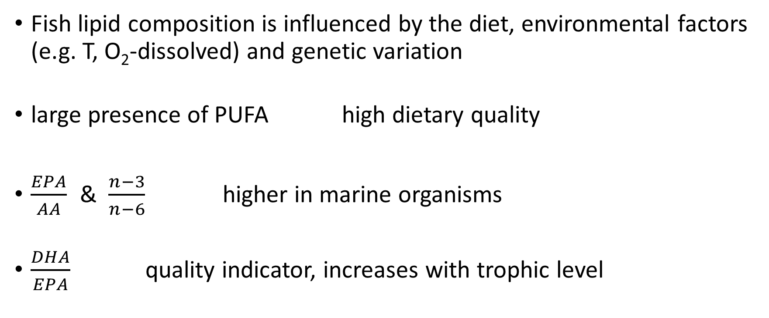
Fatty acids & fish
Fish lipid composition is influenced by the diet, environmental factors (e.g. T, O₂-dissolved) and genetic variation
large presence of PUFA high dietary quality
$\frac{EPA}{AA}$ & $\frac{n−3}{n−6}$ higher in marine organisms
$\frac{DHA}{EPA}$ quality indicator, increases with trophic level
Notes:
Fatty acids are suitable for the use as biomarkers for feeding and/or foraging behaviour. This is due to their biological specificity and the fact that many fatty acids are transferred conservatively through food webs from primary producers to succeeding trophic levels. The EPA:AA ratio is generally higher in eels reared on marine diets in aquaculture studies (Prigge et al., 2012). This is due to the fact that fatty acids are conservatively transferred through food webs. EPA has been described as one of the most abundant PUFAs in marine Bacillariophyceae (Zhukova & Aizdaicher, 1995). Also, EPA is ten times more abundant in marine green algae than in freshwater green algae (Vanderploeg, 1996). Another bioindicator for the distinction between marine and freshwater organisms is the n3:n6 ratio, with marine organisms having substantially higher ratios than freshwater organisms. Previous research on eels found that a ratio <4 is commonly considered to be typical for eels living in freshwater (Prigge et al., 2012). Another much used bio-indicator is the ratio of DHA to EPA, this biomarker is commonly used to assess the quality of fish biomass and to assess the trophic position of species. The ratio DHA to EPA should increase towards higher trophic levels (Dalsgaard, 2003).
Four biomarkers were calculated from the relative fatty acid frequencies: DHA/EPA, PUFA/(SFA + MUFA), EPA/AA (higher in marine fish) and the n-3/n-6 ratio (higher in marine fish). Univariate regression analysis was fitted on these biomarker ratios.

Slide 7
Objectives
N° of glass eel that pass V-A canal?
Differences in fish caught with different sampling techniques
Numbers
Biometrics
What is the diet of glass eel in this canal?
How does the fatty acid profile change over time?
Biomarkers
Link with diet?
Notes:
The main question of this master dissertation is how the human-made artificial canal dynamics influence glass eel. The chosen study site, a polder drainage canal, is a highly dynamic system, with heavily fluctuating environmental variables (e.g. salinity, turbidity, dissolved oxygen concentration, pH, temperature etc.) and a brackish water biota, supplemented with fresh water biota at irregular time intervals (Van Wichelen et al., 2016). This dynamic system arises due to a differing influx of polder freshwater, following polder drainage events.
This artificial, highly dynamic canal is an example of an impassable upstream migration barrier. Glass eel can enter the canal, but then they are trapped. The upstream pumping station makes it impossible for glass eel to reach the Yser polder, and they are thus forced to settle in the canal. This dynamic artificial system is exemplary for many of its kind throughout Europe. In this study, glass eel that do try and migrate through the canal or settle in the canal are the main focus. This will result in important insights as to how these fishes deal with their environment.
The glass eel were sampled in 2017 using 3 different techniques: lift nets, artificial substrates and an eel ladder. The first inquiry of this master dissertation is to characterise the arriving glass eels.
What are the numbers of glass eels that pass the canal?
What is the most successful technique for sampling glass eel
Do the caught glass eel differ in condition according to sampling method?
Are glass eels capable to increase their body condition in the canal?
Second, a snapshot of the diet of these glass eel is obtained by stomach and gut dissections.
Do glass eel sampled using different methods have the same diet?
How does the diet of the glass eel change during the sampling period?
Are wild glass eels omnivorous benthic feeders in the canal, such as the stocked eel in aquaculture ponds?
Third, the fatty acid profile of a subset of glass eel is analysed.
How does the glass eels fatty acid profile change over time?
What is the typical influence of a dynamic, artificial canal on the glass eel fatty acid profile?
How do the fatty acid biomarkers change over time?
The main objectives of this work were: (I) to typify the fatty acid profile of tail muscle of the European eel at the beginning of their upstream migration, and how these fatty acid profiles shift over time in eels that settle in the Veurne-Ambacht canal and (II) to verify muscle fatty acids shift according to the diet of these early recruits.

Slide 8
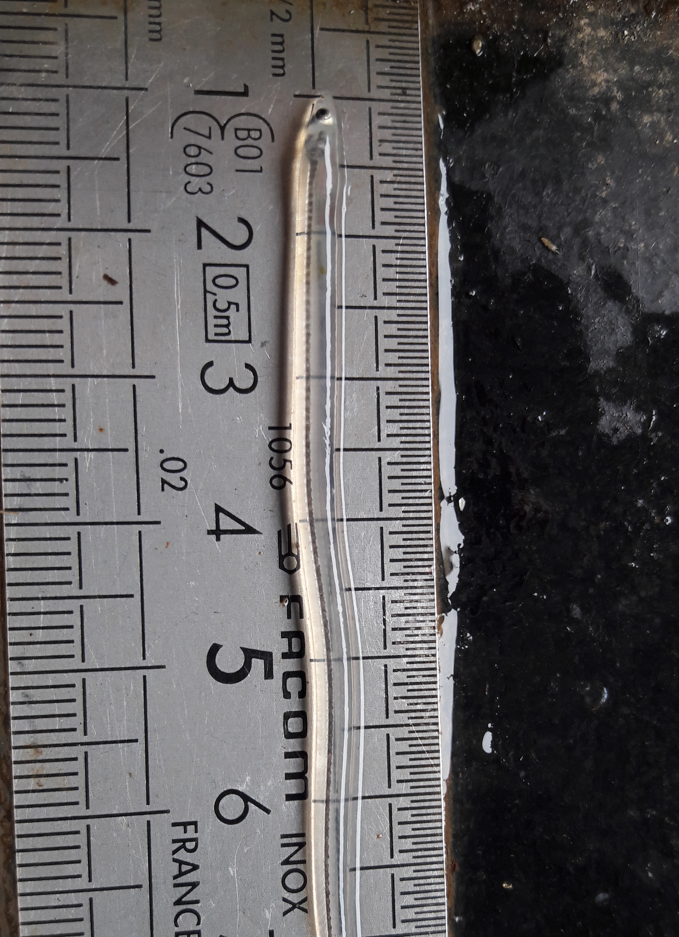
Content
Introduction
European eel – Life cycle
Natural habitat & current situation
Migration: dynamics & drivers
Fatty acids & fish
Objectives
Materials & methods
Study area
Sampling methods
Artificial substrates
Lift nets
Glass eel ladders
Parameters & Statistical analysis
Results
Diet
Artificial Substrates
Eel ladder
Fatty acid analysis
Discussion & take-home message

Slide 9
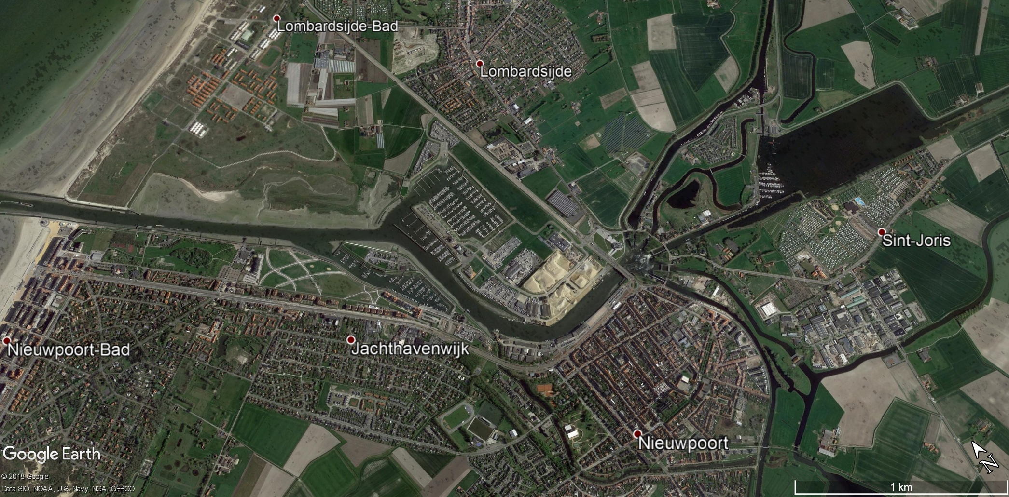
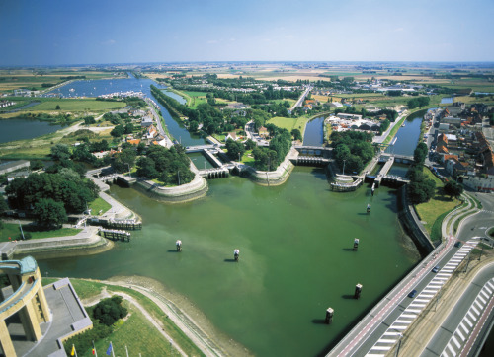
Study area
Notes:
In Belgium we have plenty of examples of habitat fragmentation for migratory fish. One example is to be found in Nieuwpoort. The picture on the left shows the Yser mouth with the sea on the left and the Ganzepoot on the right. The Yser mouth is thus connected with a sluice complex which connects and controls 6 waterways.

Slide 10
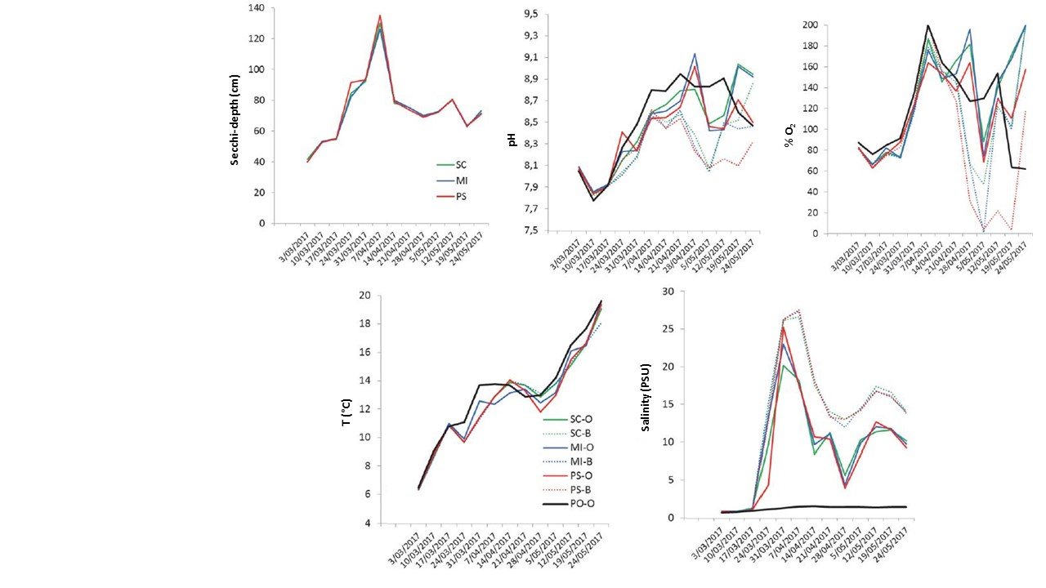
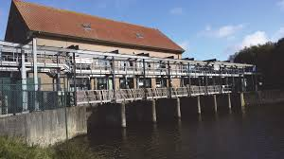
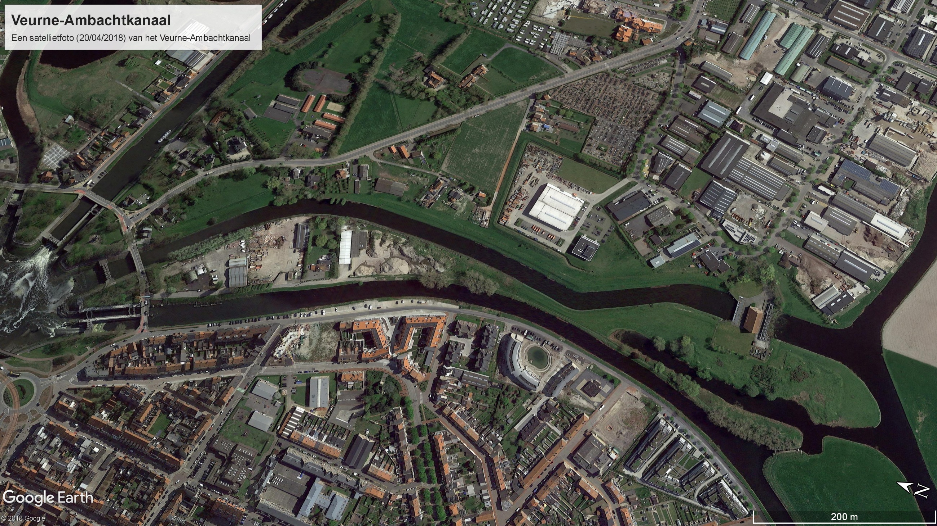
Study area
Notes:
One of these waterways connected with the Ganzepoot is the Veurne-Ambacht canal. This canal connects the Veurne-Ambacht polder with the Yser mouth. It is a drainage canal, controlling the water level of the upstream polder. With ebb tide, the sluices are opened which allows the polder water to flow out to the sea. With flood tide the sluice gates are locked, which prevents salination of the polder. In order to do so, a pumping station was built. This is pictured on the top right. The station pumps water out of the polder into the canal, when polder water levels are high.
Since 2017 adjusted tidal barrier management is applied. Hereby sluice doors were opened for a while during rising tide. This allows more glass eel to migrate into the canal. However, without further help these glass eel would be stuck in this highly dynamic canal. Luckily, eel ladders are installed and glass eel are moved into the polder area.

Slide 11
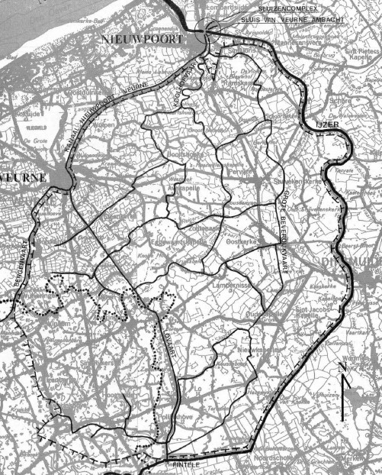
20,000 ha polder
Lots of connected streams
Notes:
Eenmaal voorbij het pompgemaal krijgen de glasaaltjes een uitgebreid gebied ter beschikking: de Veurne-Ambachtse polder. Een gebied dat 20,000 ha beslaat. In de zuidwesthoek een beekgebied van 4,000 ha behorende tot de zandleemstreek, de rest is bodemkundig echte polderstreek. Je ziet de duidelijke netstructuur van waterlopen. Dit gebied is al eeuwen een populair habitat bij paling.

Slide 12
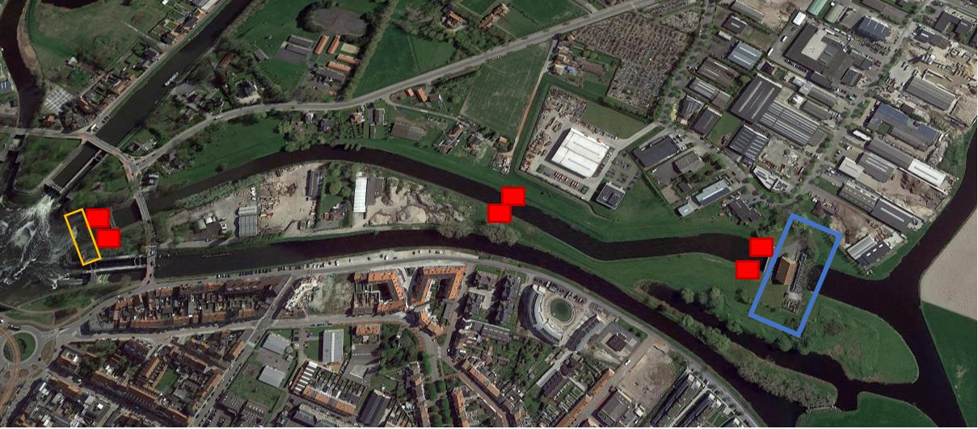
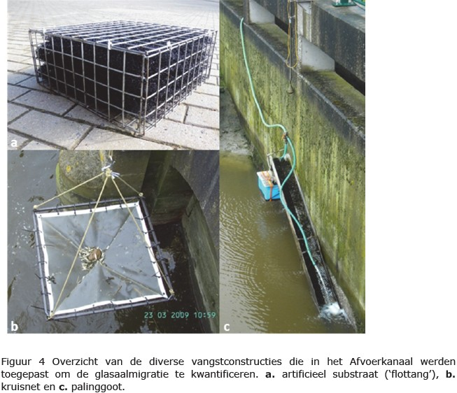
Sampling techniques
N = 2
(at pumping station)
17/02/2017 – 24/05/2017
Weekly checked, 2x per week during migration peak
N = 18
(3 per location, 6 locations)
50X50X20 cm
24/02/2017 – 24/05/2017
Weekly checked
N = 4, 4 times per sampling
(at pumping station)
1 m²
11/03/2017 – 30/04/2017
Weekly sampling
Notes:
To sample glass eel recruits in this canal, 3 sampling methods were applied:
Artificial substrates
Artificial substrates are floating artificial plastic substrates embedded in an iron frame (50x50x20cm). The plastic substrates are 3D nylon stabilisation mats (Enkamat®). These were installed from 24/02/2017 to 24/05/2017. Substrates floated with the mats inundated in the upper canal water column. Six sampling locations were present, each with three artificial substrates installed next to each other (Figure 5); one location after the sluices connecting the Ganzepoot and the Veurne-Ambacht canal; one location in the middle of the drainage canal and one location at the pumping station. For each location, three artificial substrates were placed at each river bank, consequently 18 artificial substrates were thus placed in the Veurne-Ambacht canal.
Lift nets
Lift nets ( Figure 6b) were used (surface: 1 m²) weekly (from 11/03/2017 to 30/04/2017) to sample glass eel at the nine different pumping station lock. Each sampling effort, lift net fishing was repeated four times with four lift nets each time.
Glass eel ladders
Glass eel ladders were installed in 2017, one at each side of the Veurne-Ambacht pumping station. These eel ladders are gutters whereby a lower part is inundated in the canal, and a higher part which is connected to a collecting bin (Figure 6c). The gutter surface consists of brushes which are (from 17/02/2017 to 24/05/2017) constantly irrigated with polder freshwater, pumped from the pumping station emergency sewers. To further attract glass eel, the base of the gutter was also watered with polder freshwater. The structure inclination was 30°. The glass eel needed to climb 1-2 m (dependent on the canal level) to reach the above collecting bin. The bin was weekly checked, or more frequent during the glass eel migration peak.
Indicated in blue is the pumping station, in yellow the Ganzepoot sluices

Slide 13
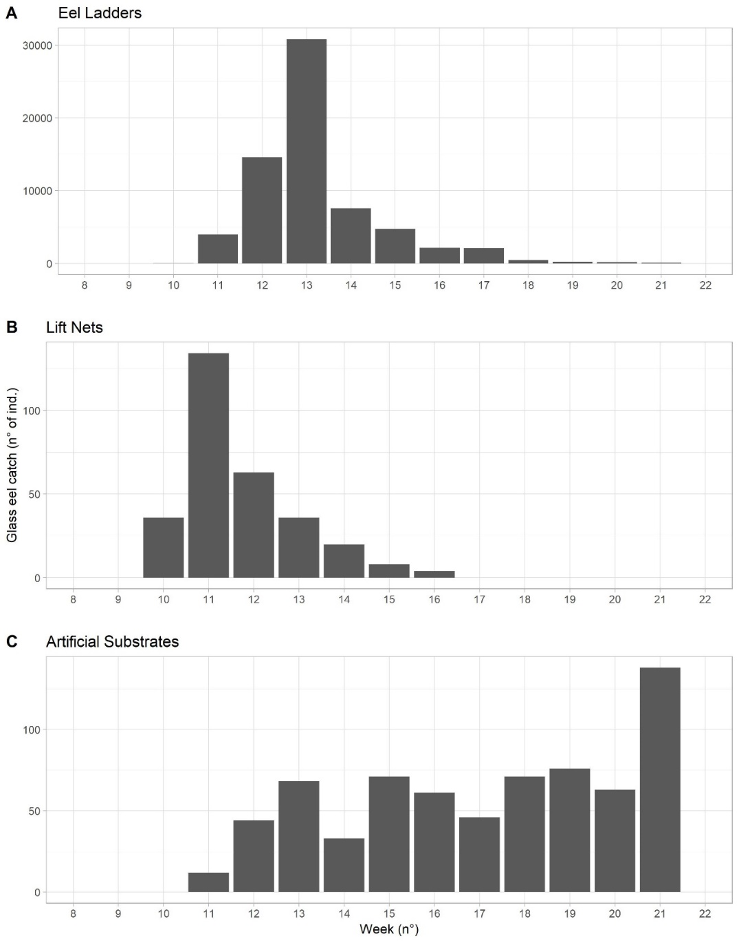
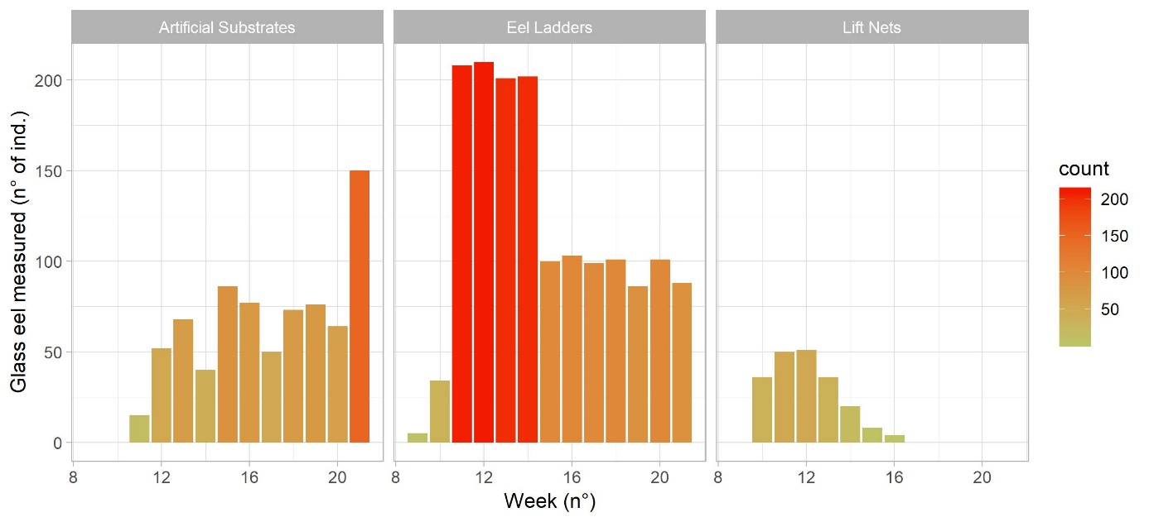
Sampling effort & catch results
N_{tot} = 66963
N_{meas.} = 1538
N_{tot} = 301
N_{meas.} = 205
N_{tot} = 683
N_{meas.} = 683
Notes:
In the eel ladder, a total of 66963 glass eel were caught in 2017. The peak in recruitment was week 13, with 31,000 glass eel recruits in one week. Using the lift nets, a total of 301 glass eel were caught, peaking at week 11. A total of 683 glass eel were caught in the artificial substrates, with a peak in abundances at week 21 (Figure 7). Of these caught glass eel, a subset of individuals were biometrically characterised (Figure 8). In week 11, 12 and 13 abundances were peaking in the eel ladders, upon which the bin was emptied twice a week. If more than 100 glass eel were present, only 100 were measured. If numbers of measured glass eel exceeds 100 for a given week (Figure 8), this is due to the multiple sampling effort during these weeks. From the artificial substrates, a total of 751 glass eels were measured; 1538 glass eel were measured from the eel ladders and 205 glass eels caught using lift nets were measured.

Slide 14
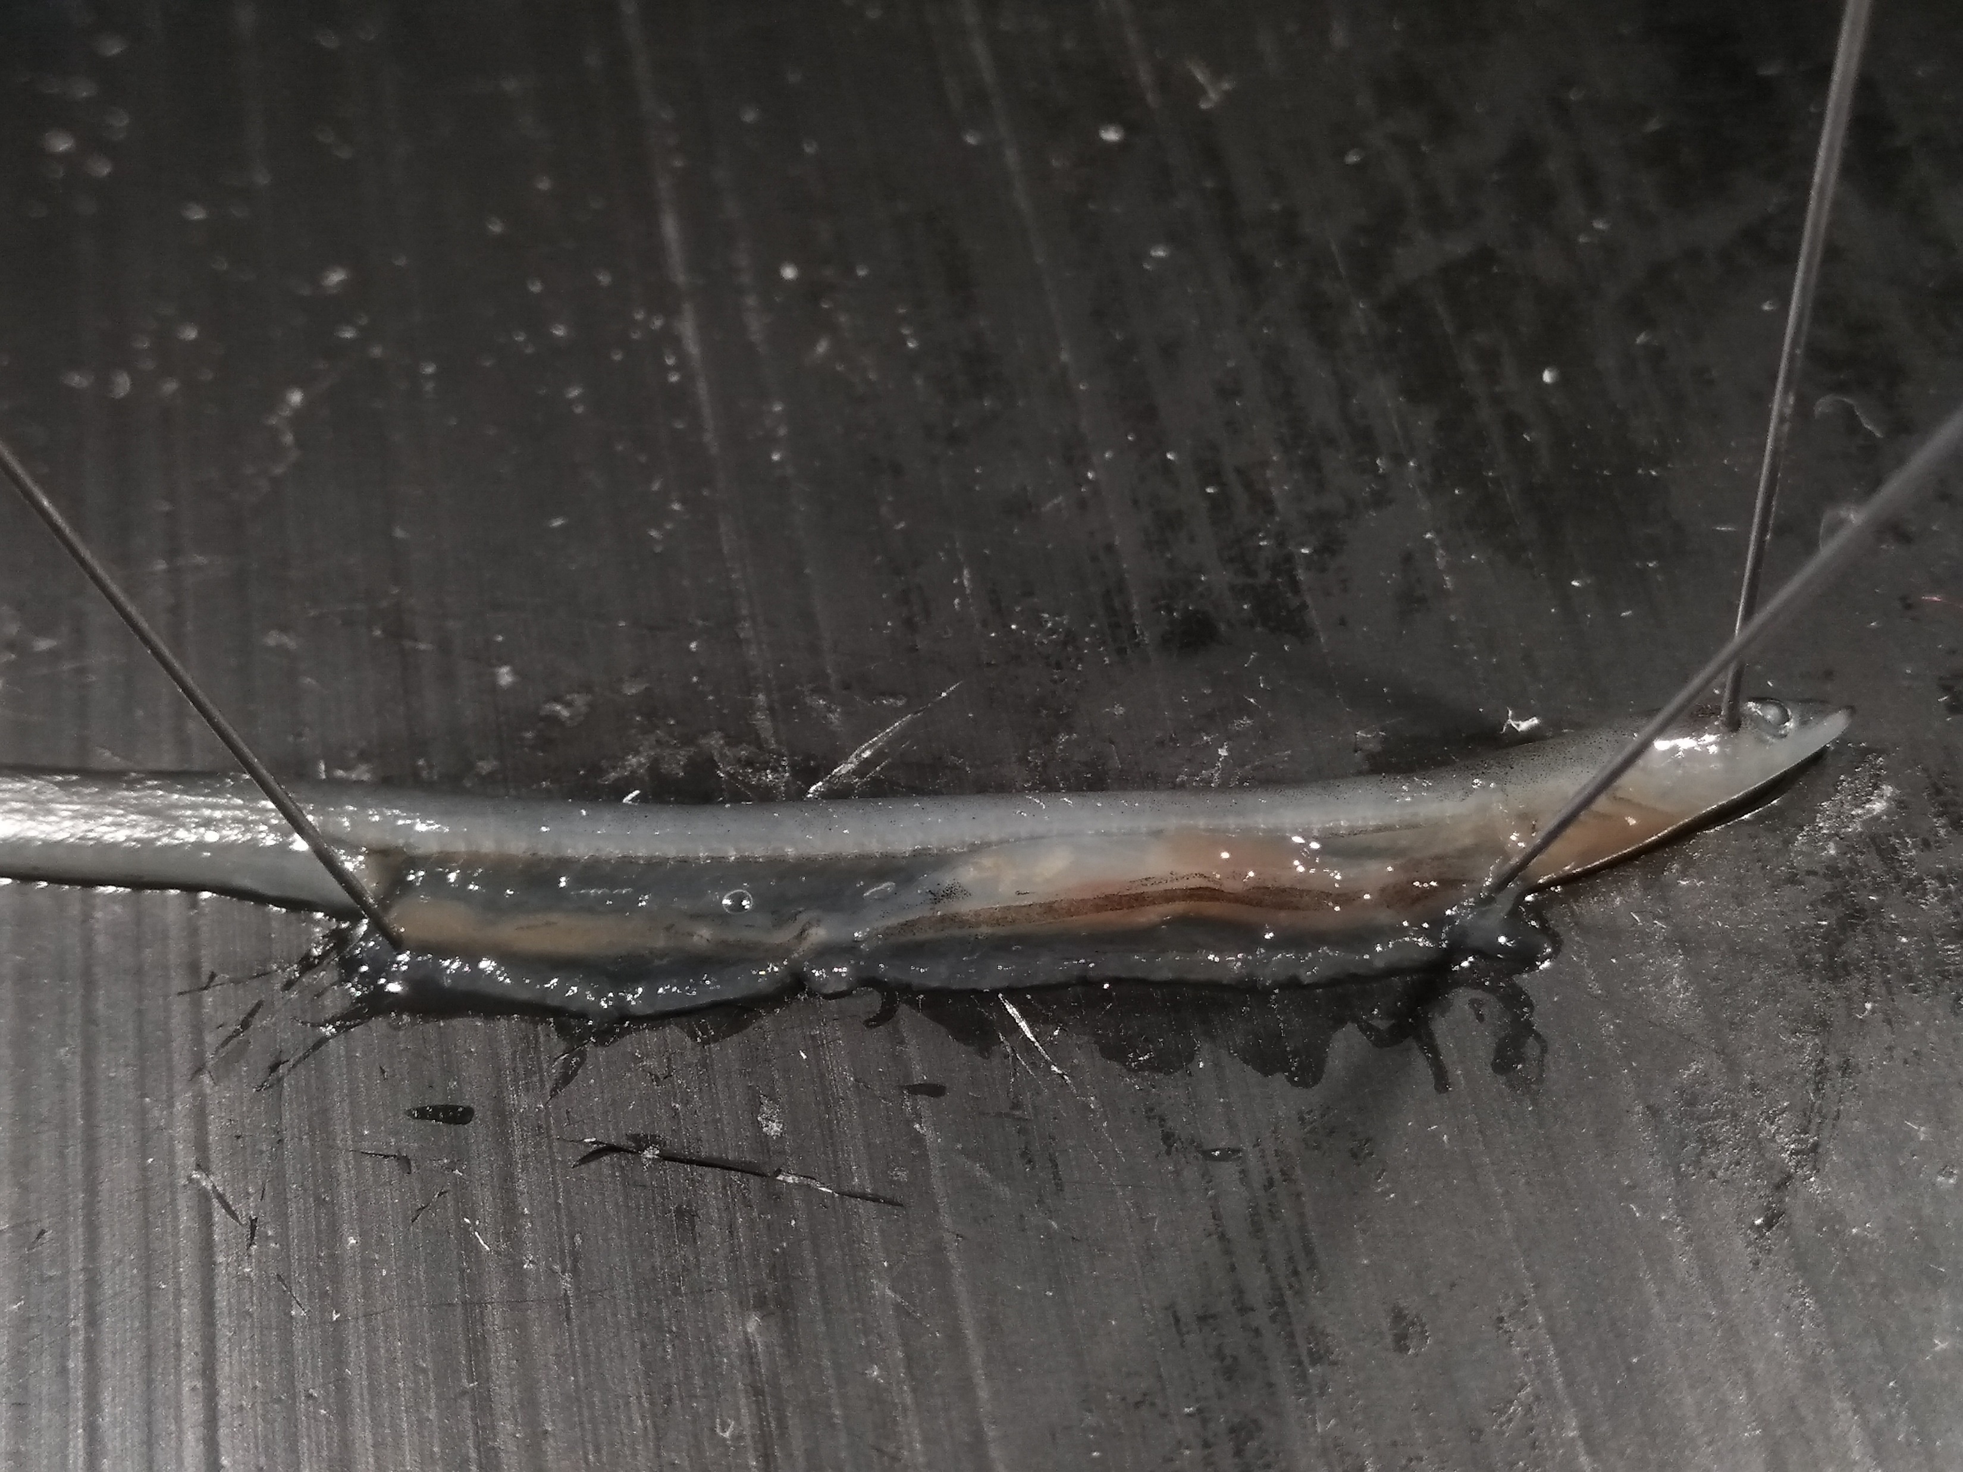
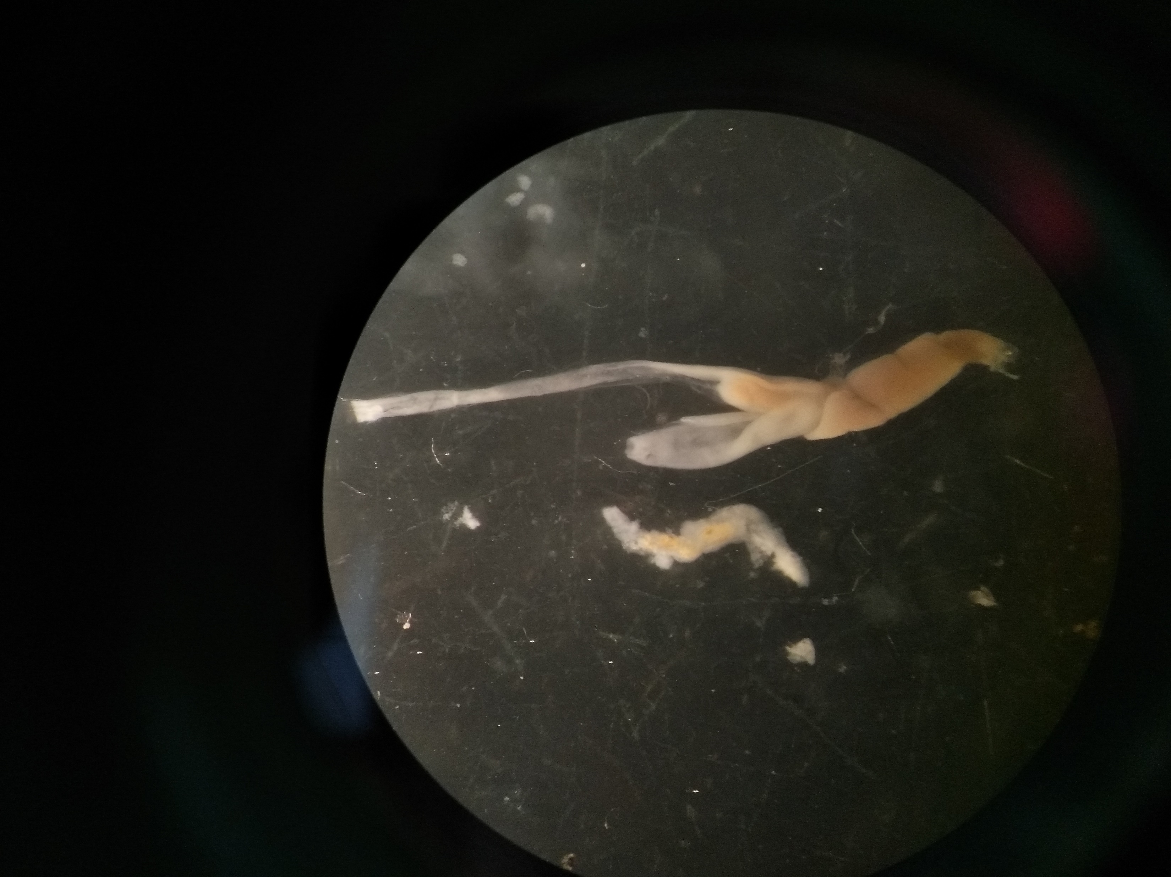
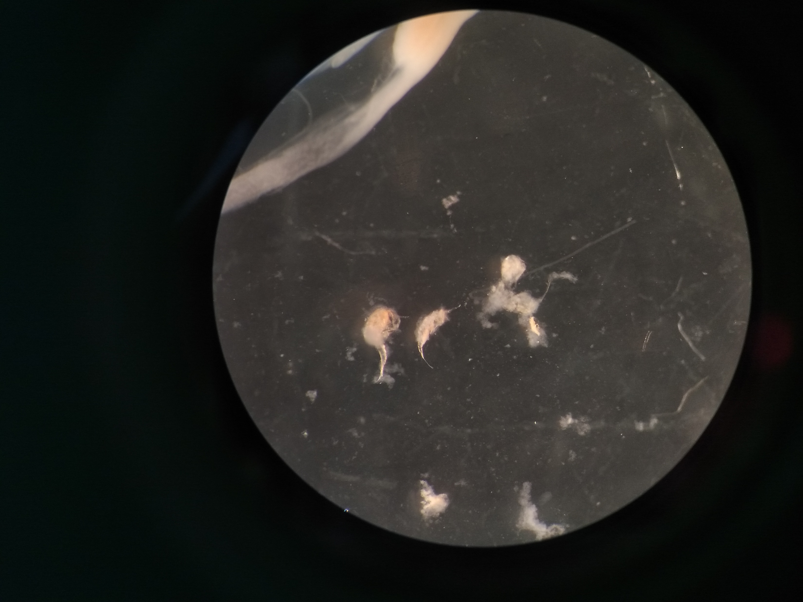
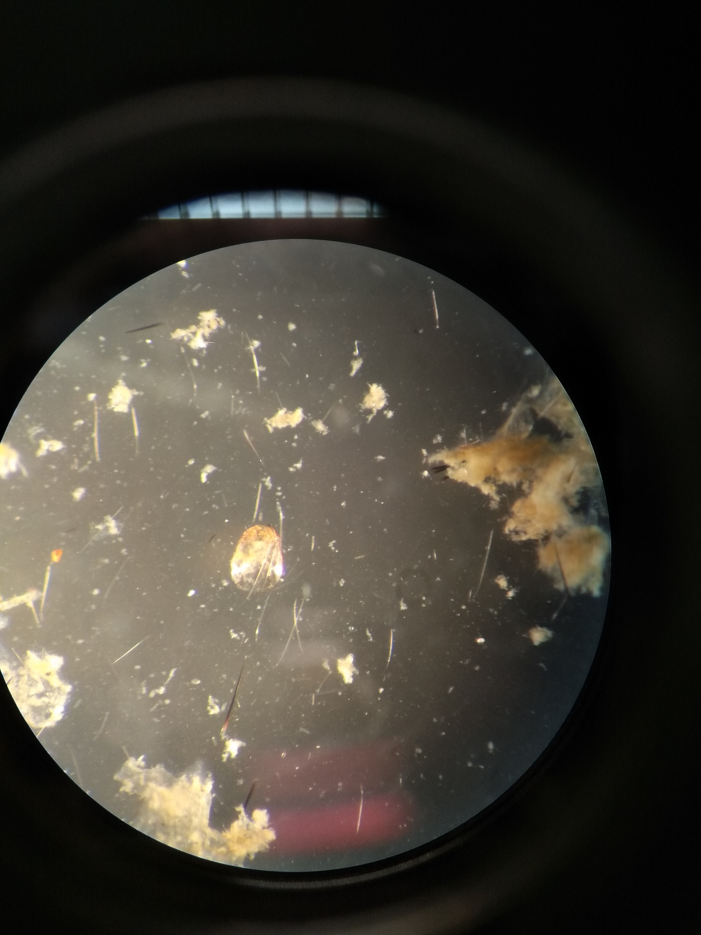
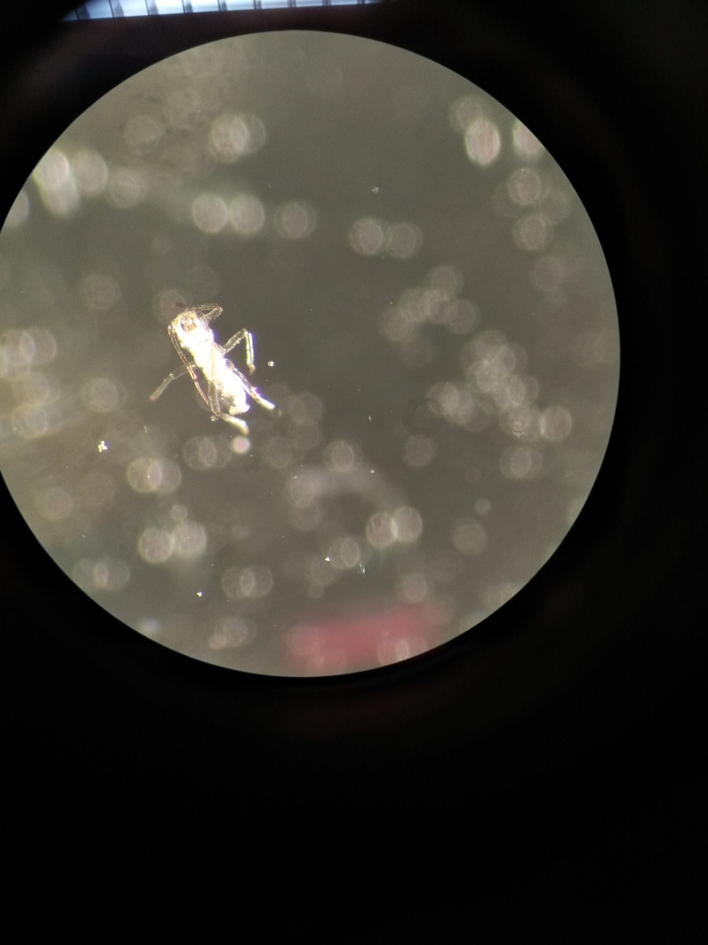
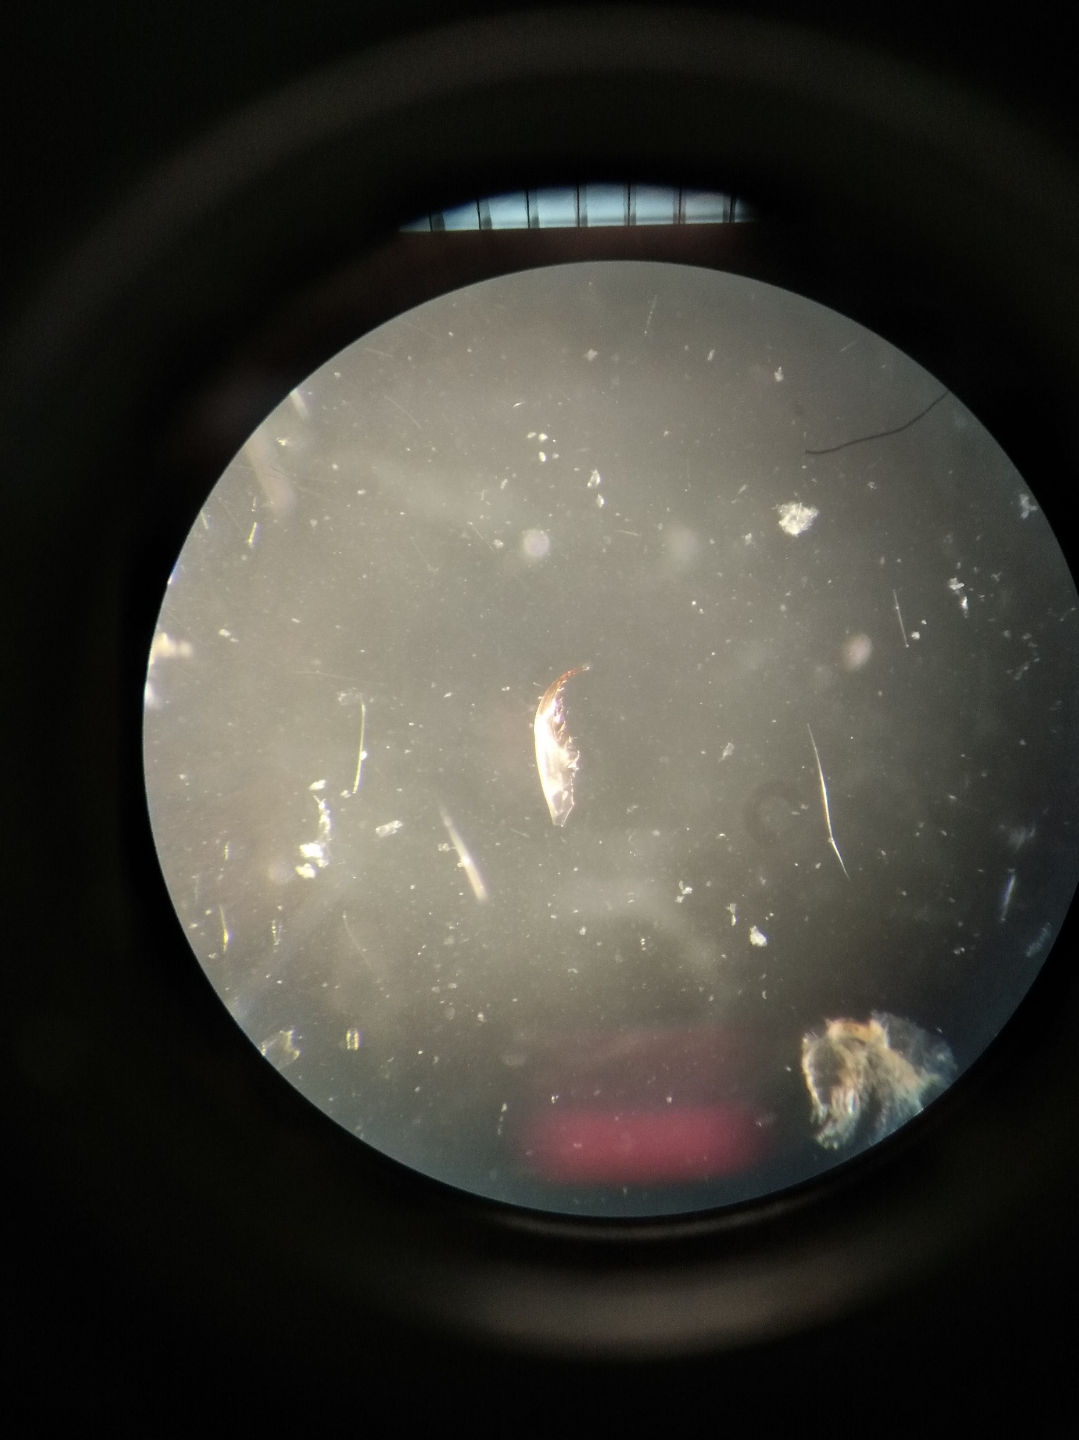
Dissections
N = 276
Glass eels were weighed
Stomach and gut content analys
Ventral cut from gill arch towards anus
Preserve part of the tail for fatty acid analysis
Stomach and intestinal tract excised and weighed
Gut and stomach content excision & analysis
Classification of prey items on the furthest possible taxonomic level
Notes:
276 of the glass eel caught in 2017 were permanently kept in freezers. On these individuals, stomach and gut content analyses were performed. After defrosting, a ventral cut was made from the glass eels’ gill arch towards the anus. The stomach and intestinal tract were excised and weighed. After, both were placed in a petri dish and submerged in distilled water. With tweezers and needles the content of the gut and stomach was excised under a binocular. The different prey items were classified on the furthest possible taxonomic level.

Slide 15
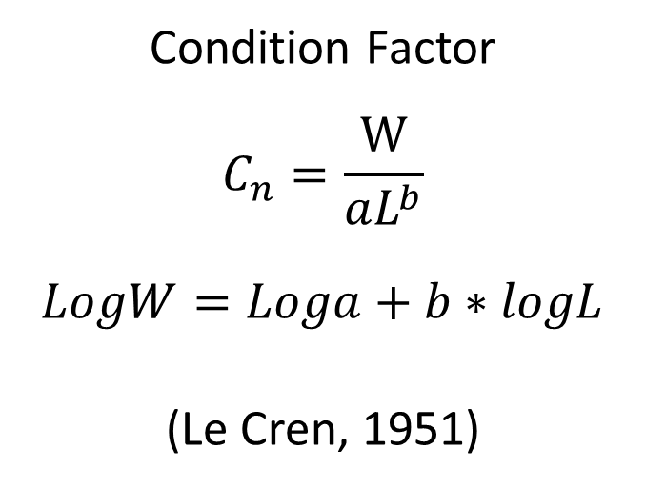
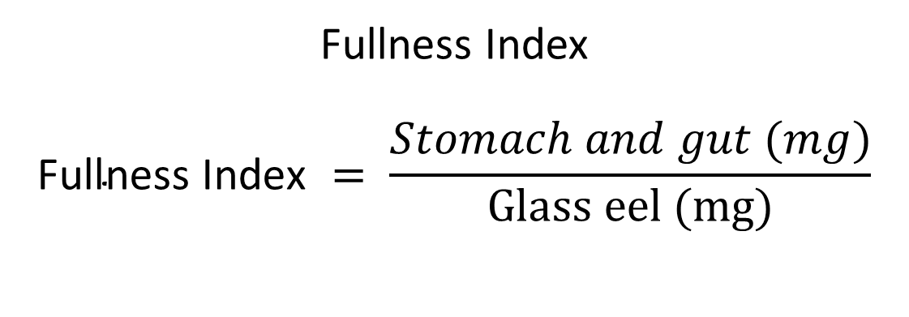
Biometric parameters
Fullness Index
$$\text{Fullness} \text{Index} = \frac{Stomach and gut (mg)}{Glass eel (mg)}$$
Condition Factor
$$C_{n}=\frac{W}{aL^{b}}$$
$$LogW=Loga+b∗logL$$
(Le Cren, 1951)
Notes:
Fullness Index
The Fullness Index (FI) is often used as a measure to indicate the biomass of the stomach and gut content and is calculated as:
Fullness Index $= \frac{Stomach and gut (mg)}{Glass eel weight (mg)}$
Glass eel were weighed before dissection, and this weight is used to calculate the fullness index.
Condition factor
To analyse body condition, the relative condition factor (C_{n}) was used (Le Cren, 1951). K_{n} takes allometric growth into account; when <1, fish are in a worse condition than expected, while >1 fish are indicates a better condition:
$$C_{n}=\frac{W}{aL^{b}}$$
Where a is a constant and b an exponent varying from 2.5 to 4. B = 3 indicates isometric growth (b < 3 for fish becoming more fusiform as they grow and b > 3 for fish becoming progressively less slender). In the formula, total length (L) and body weight (W) have a logarithmic relationship:
$$LogW=Loga+b∗logL$$
where b is the slope of the line and log a the intercept (Le Cren, 1951).

Slide 16
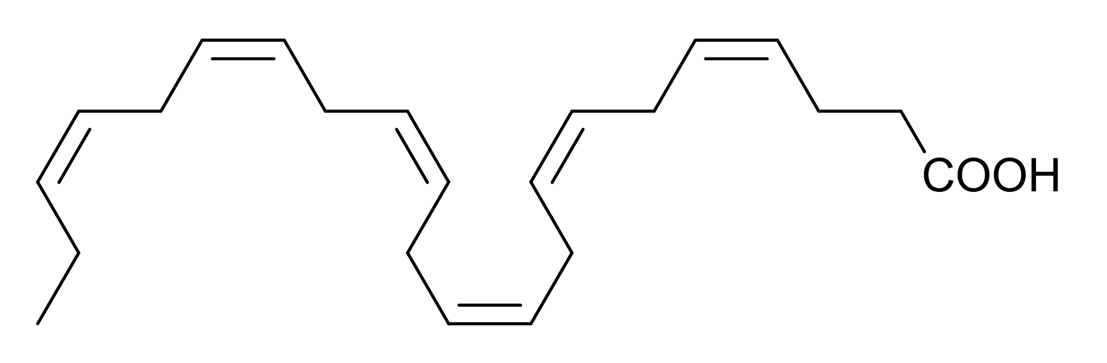
Fatty acids
N = 147
N_{AS} = 94 N_{EL}= 31 N_{LN} = 9
muscle tissue from tail: main fat reserve, intact after dissection
Gas chromatography – Mass spectrometry (GC-MS)
Notes:
Fatty acid analysis was performed on a subsample of 147 glass eel. The focus was the glass eel sampled from artificial substrates (N = 94), but smaller samples of glass eel from the eel ladder (N = 31) and lift nets (N = 9) were analysed as well. In this study we have analysed the tail muscle of the fish since it comprises the main fat reserve, and remained intact after the dissection.
Sample preparation
Fatty acid methyl esters were prepared from freeze-dried samples using a direct transesterification procedure with 2.5% (v:v) sulfuric acid in methanol as described by De Troch et al. (De Troch et al., 2012). The frozen samples were first freeze-dried to eliminate water molecules. After lyophilisation, 1.5mL sulfuric acid in methanol (2.5%, v:v) and The internal standard (19:0, 15 µg) was added. Then, samples were incubated for 90 minutes in a hot water bath of 80°C. Afterwards, samples were cooled to room temperature, after which 0.76mL hexane and 0.76mL 0.9% NaCl were added. Samples were then vortexed for 20 seconds and then centrifuged for 10 minutes at 1200 rpm at 4°C. The supernatants is then transferred to a 7 mL tube and kept cool. Extraction of fatty acid methyl esters was repeated and an aliquot of the combined extract was stored in vials at -20°C until analysis.
Sample analysis
Composition analysis of fatty acids was carried out using a gas chromatograph (HP 7890B, Agilent Technologies, Diegem, Belgium) equipped with a flame ionization detector (FID) and connected to an Agilent 5977A Mass Selective Detector (Agilent Technologies, Diegem, Belgium). The GC was further equipped with a PTV injector (CIS-4, Gerstel, Mülheim an der Ruhr, Germany). A 60m×0.25mm×0.20μm film thickness HP88 fused-silica capillary column (Agilent Technologies, Diegem, Belgium) was used for the gas chromatographic analysis, at a constant Helium flow rate (2 mL/min). The injected sample is split equally between the MS and FID detectors at the end of the GC column using an Agilent capillary flow technology splitter. The oven temperature program was as follows: at the time of sample injection the column temperature was 50°C for 2 min, then gradually increased at 10°C/min to 150°C, followed by a second increase at 2°C/min to 230°C. The injection volume was 1 μL. The injector temperature was held at 30°C for 0.1 min and then ramped at 10°C/s to 250°C and held for 10 min. The transfer line for the column was maintained at 250°C. The quadrupole and ion source temperatures were 150 and 230°C, respectively. Mass spectra were recorded at 70 eV ionization voltage over the mass range of 50 - 550 m/z units.
Data analysis was done with Agilent MassHunter Quantitative Analysis software (Agilent Technologies, Diegem, Belgium). The signal obtained with the FID detector was used to generate quantitative data of all the compounds. Peaks were identiﬁed based on their retention times, compared with external standards as a reference (Supelco 37 Component FAME Mix, Sigma-Aldrich, Overijse, Belgium) and by the mass spectra obtained with the Mass Selective Detector. Quantiﬁcation of fatty acid methyl esters was based on the area of the internal standard (19:0) and on the conversion of peak areas to the weight of the fatty acid by a theoretical response factor for each fatty acid (Ackman & Sipos, 1964; Wolff et al., 1995).

Slide 17
Statistics
Biometric & Biomarker analysis => univariate statistics: polynomial regression
Fatty acid analysis => multivariate statistics: n-MDS

Slide 18
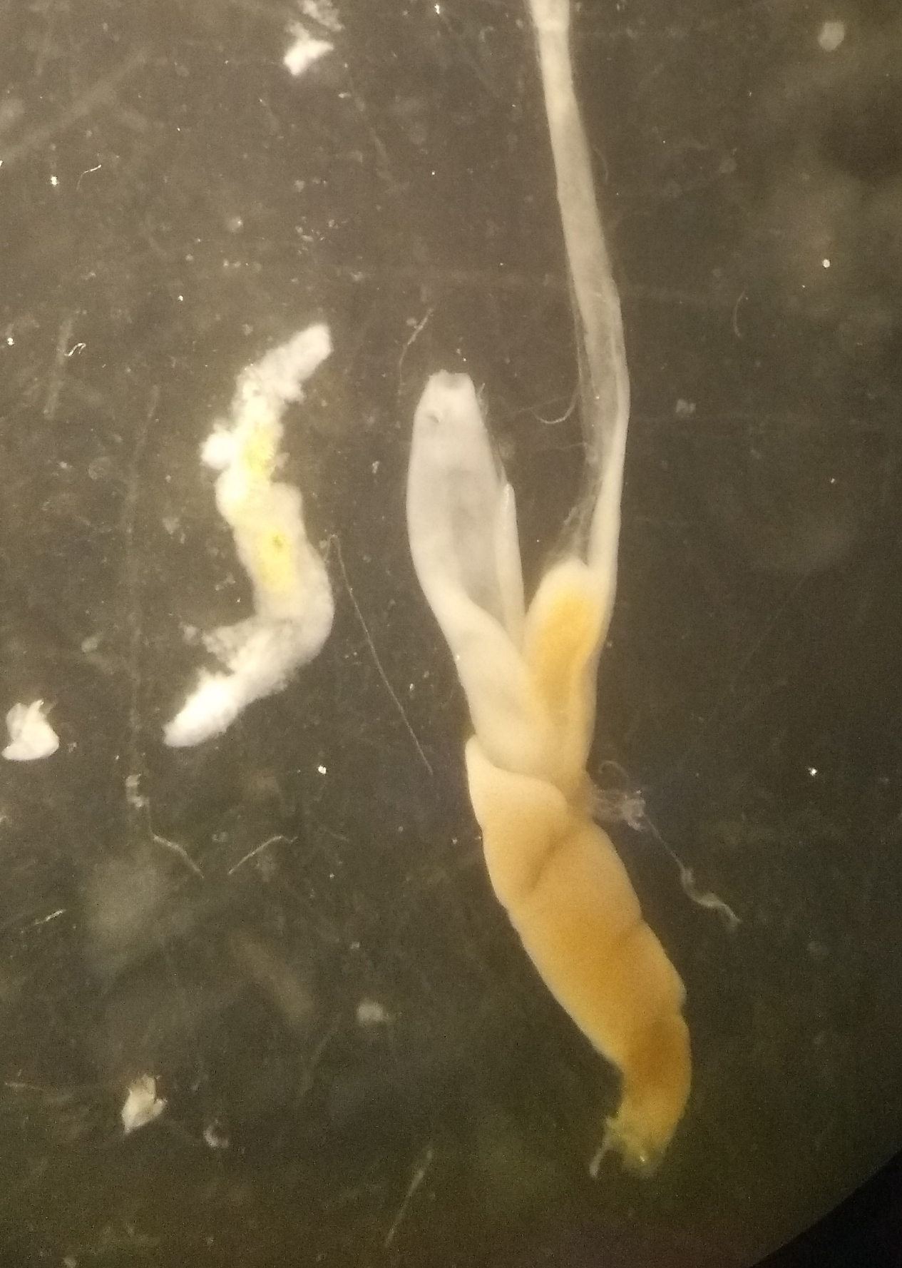
Content
Introduction
European eel – Life cycle
Natural habitat & current situation
Migration: dynamics & drivers
Fatty acids & fish
Objectives
Materials & methods
Study area
Sampling methods
Artificial substrates
Lift nets
Glass eel ladders
Parameters & Statistical analysis
Results
Diet
Eel ladders
Artificial Substrates
Fatty acid analysis
Discussion & take-home message

Slide 19
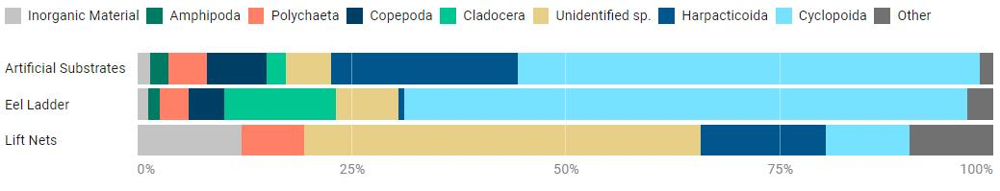
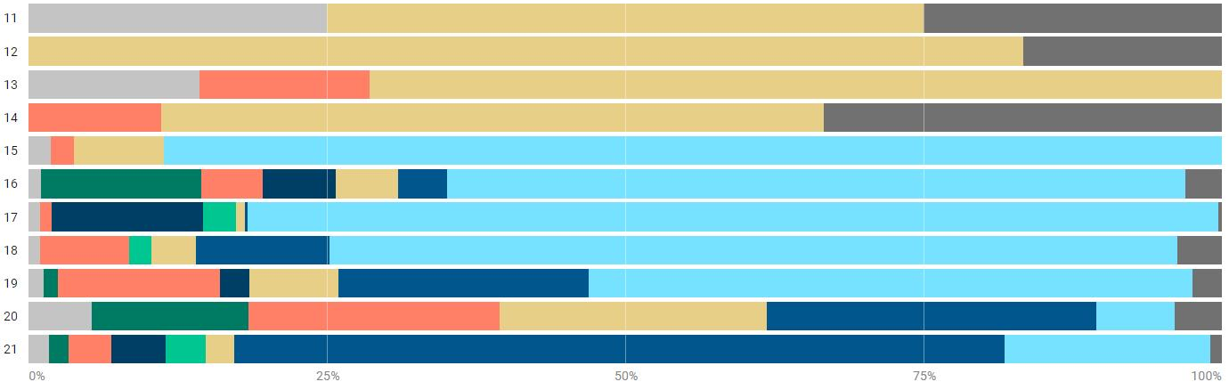
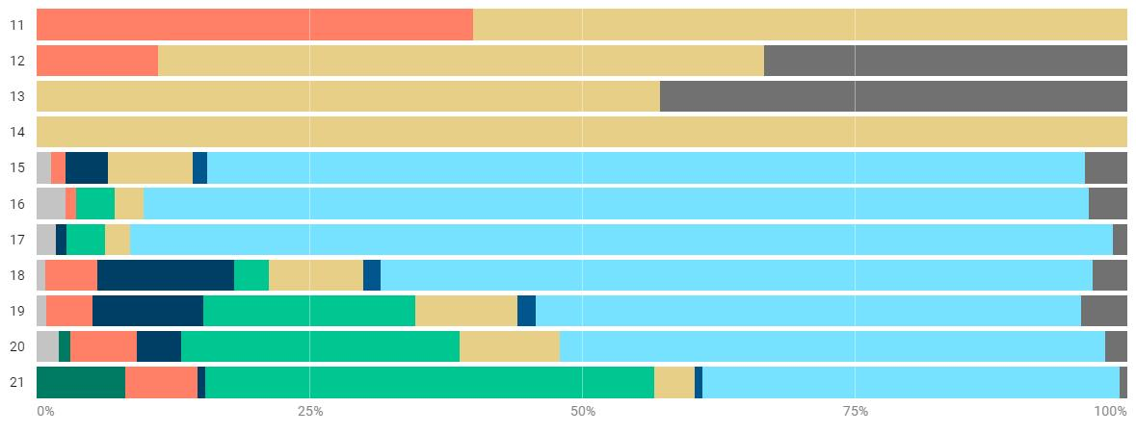
Diet
Artificial substrates
Eel Ladders
Notes:
Stomach and gut content according to method
Glass eels’ stomach and gut content (N = 276) showed relative differences according to the method (Figure 10). Absolute prey occurrence numbers were scaled, i.e. the total number of that prey species found in the glass eel guts and stomachs to the total abundance of that prey species for the used method or week. These average relative abundances are than used to construct the plots. The artificial group ‘others’ consists of prey items of which less than 40 individuals were recorded (Annelida sp., Coleoptera sp., Diatomea, Isopoda sp., Hexapoda sp., Diptera sp., Crustacea sp., Calanoida sp., Chironomidae & Plantae sp.).
In the artificial substrates, the most abundant prey species were cyclopoid copepods (54%), followed by harpacticoid copepods (22%), Copepoda sp. (7%), unidentified sp. (5%), Polychaeta (4.5%), Cladocera sp. (2%), Amphipoda sp. (2%), inorganic material (2%). The remaining 2% belongs to the assembly group ‘others’.
The glass eels caught in the eel ladders also had cyclopoid copepods as the most abundant prey item (66%), followed by Cladocera sp. (13%), unidentified sp. (7%), Copepoda sp. (4%), Polychaeta (3%), harpacticoid copepods (1%), inorganic material (1%), Amphipoda sp. (1%). The assembly group ‘others’ takes up 3% of the relative stomach and gut content.
The glass eels caught in lift nets mostly had unidentified sp. in their stomachs and guts (46%), followed by harpacticoid copepods (15%), inorganic material (12%), cyclopoid copepods (10%) and polychaetes (7%). The assembly group ‘others’ takes up 10% of the relative stomach and gut content.
Stomach and gut content over time in the Veurne-Ambacht canal
The stomach and gut content of glass eel sampled in artificial substrates changes substantially over time. From week 11 until week 14, stomach and gut content consists mostly of unidentified sp. (Figure 11). This group is mostly unidentifiable white semi-digested organic matter found at the end of the gut, with an otherwise empty stomach and gut. Another abundant group in this period is inorganic matter, and to a lesser extent polychaete sp. From week 15 onwards, Cyclopoid copepods become the most abundant group in the glass eel diet. From then on, the contribution of cyclopoid species declines. While cyclopoid copepods decline, harpacticoid copepod contribution to the glass eel diet grows, from 4.1% ( Week 16) towards 65% at the end of the sampling period. Polychaete contribution varies from 14% (Week 13) to a low of 1% (Week 17), after which numbers increase again to 21% (Week 20).
Stomach and gut content in the eel ladders Amphipods were only found in week 20 (1%) and week 21 (8%) (Figure 13). Polychaetes were most abundant in week 11 (40%), followed by week 12 (11%). Cladocera are found from week 16 onwards (3.6%), but abundances exponentially grew since week 19, with the highest abundances in week 21 (41% of gut and stomach contents). Harpacticoid copepods are not very abundant, their contribution to the stomach and gut content never exceeds 1.7%). Cyclopoids are the most abundant prey group from week 15 to week 21, with the highest abundance in week 17 (90%).

Slide 20
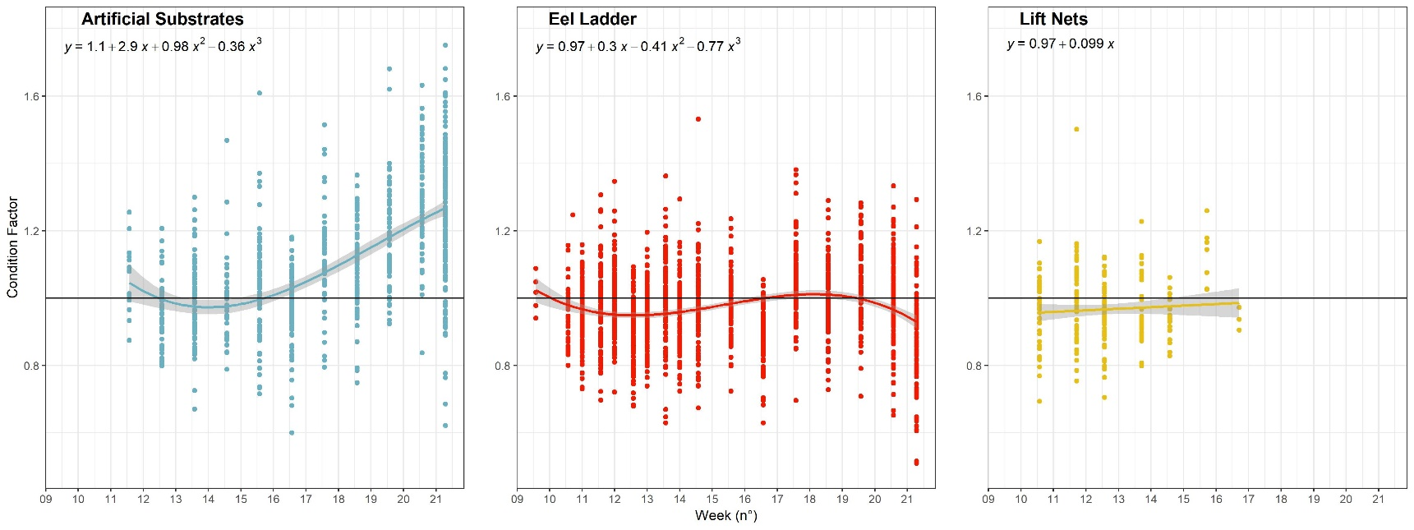
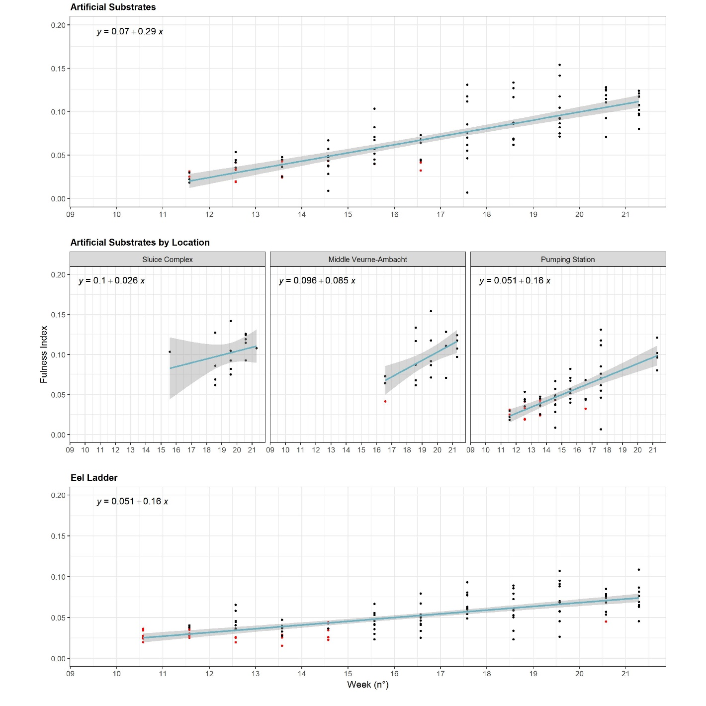
Eel ladders

Slide 21
Artificial substrates

Slide 22
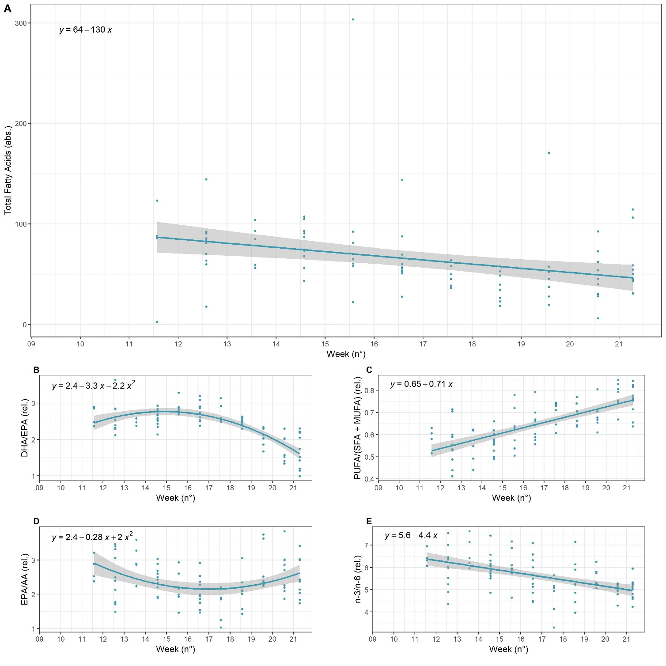
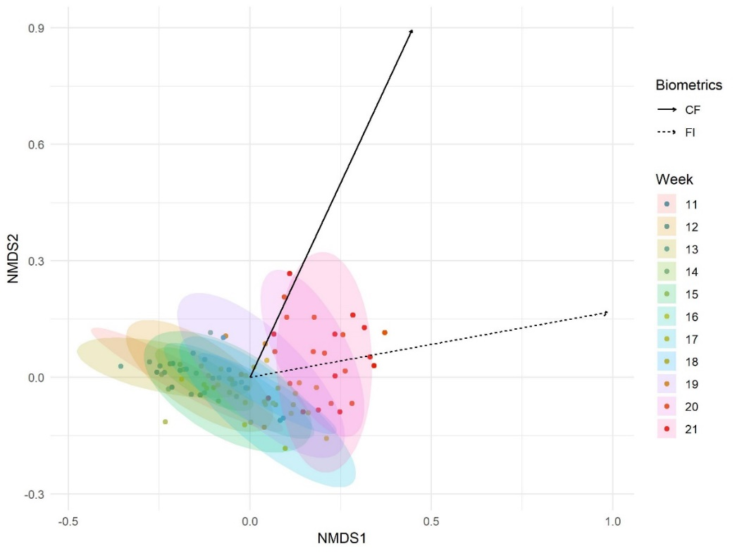
Fatty acid analysis
Change in overall fatty acid profile is concurrent with an increase in CF & FI
Notes:
First, the pattern in total fatty acid concentration (absolute values) declines linearly over time (Figure 18). The linear regression equation is [FA]_{total} ~ 58 – 100*T (R²-adj. = 0.18). Exact mean values can be obtained from Table S3. At week 11, the mean absolute fatty acid concentration was 74.68 mg FA/g dry weight. At week 21, the mean absolute fatty acid concentration declined to 53.94 mg FA/g dry weight.
The mean absolute fatty acid concentration also differed between sampling methods. A mean absolute fatty acid concentration of 63.86 mg FA/g dry weight was characteristic for the artificial substrates, the glass eel sampled at the eel ladder had a mean absolute fatty acid concentration of 114.15 mg FA/g dry weight and the glass eel sampled with the lift nets had a mean absolute fatty acid concentration of 70.98 mg FA/g dry weight (Table S5). But caution with these numbers is implied, since the numbers of analysed samples differed for the three methods; from the artificial substrates, 94 samples were analysed, from the eel ladder 31 samples were analysed and only 9 samples were analysed from glass eel caught with the lift net method.
Considering the location of the sampled glass eel from the artificial substrates, different mean absolute fatty acid concentrations were observed as well. At the Ganzepoot sluices, mean absolute fatty acid concentration was 45.66 mg FA/g dry weight (N = 16), in the middle of the canal the mean absolute fatty acid concentration was 66.67 mg FA/g dry weight (N = 21) and at the pumping station the mean absolute fatty concentration was 49.50 mg FA/g dry weight (Table S4).
When looking at the biomarker ratio DHA/EPA, of glass eel sampled at the artificial substrates in the Veurne-Ambacht canal, the concentration initially increased until week 14, and declined from week 15 onwards. The exponential regression equation is DHA/EPA ~ 2.4 - 3.3*T - 2.2*T² (R²-adj. = 0.62). DHA (22:6 (n-3)) followed a fluctuating pattern. A peak in week 18 can be observed, after which the relative importance of the FA declined (Figure S1, F). EPA (20:5 (n-3) rose exponentially from week 15 onwards (Figure S1 , E). When plotting the ratio of concentrations of all poly-unsaturated fatty acids (PUFA) and highly unsaturated fatty acids (HUFA) summed, on the sum of the relative concentrations of the short-chain fatty acids (SFA) with the relative concentrations of mono-unsaturated fatty acids (MUFA) a linear increase can be observed. The relative importance of PUFA and HUFA increased from 54% of the concentration of SFA and MUFA combined, towards 75% at the end of the sampling period. Over the course of the sampling period, PUFA thus became much more important in the fatty acid composition of the glass eel sampled in artificial substrates in the Veurne-Ambacht canal. The found linear regression equation is: (PUFA+HUFA)/(SFA + MUFA) ~ 0.65 + 0.71*T (R²-adj. = 0.52).
Omega-3 fatty acids showed different fluctuations in relative concentrations over time. Three omega-3 fatty acids declined: 18:3 (n-3), 18:4 (n-3) and 20:4 (n-3) (Figure S1). Three omega-3 fatty acids increased or fluctuated: 20:5 (n-3) (EPA), 22:5 (n-3) and 22:6 (n-3) (DHA) (Figure S1). Omega-6 fatty acids either stayed at the same relative concentration (18:2 (n-6), or increased linearly (20:3 (n-6), 20:4 (n-6), 22:5 (n-6). Glass eel lose their marine signature according to the omega-3 to omega-6 fatty acid ratio. At week 21, this ratio is 5,63 while it is still 7,89 at week 11 (Figure 18E). The ratio follows the regression equation [n-3/n-6] ~ 5.6 – 4.4*T (R²-adj. = 0.28). The initial shift away from a more marine signature is confirmed by the EPA/AA-ratio, which is typically lower in freshwater fish than in marine fish. This ratio declines until week 17, after which it increases again (Figure 18 D), according to the regression equation [EPA/AA] ~ 2.4 – 0.28*T + 2*T² (R²-adj. = 0.11).
The relative importance of the short-chain unsaturated fatty acid 16:00 declined during the sampling period (Table 2). The short-chain fatty acid that had a large contribution in the shift in fatty acid profile over time (18:00, Figure 17) increased over time following the regression equation [18:00] ~ 7.5 + 10*T + 1.6*T² (R²-adj. = 0.77). 18:1 (cis-9) also had a significant contribution to the shift in fatty acid profiles over time, and declined during the sampling period.
Samples analysed from the eel ladder were not as numerous as those in the Veurne-Ambacht canal, but was nonetheless explored for some samples (N = 31). One outlier was deleted from the eel ladder dataset, since the total fatty acid concentration in that sample was 1674.3 mg FA/g dry weight, which masked the deceasing pattern in other samples. There was also a decline in absolute fatty acid concentrations, but the average absolute fatty acid concentration was much higher than those of the glass eel from the Veurne-Ambacht canal artificial substrates (Figure S4). The decline slope also is much steeper (-160 vs -100). Due to the lack of samples, no significant trend could be fitted for the DHA/EPA. The pattern in the figure is merely visually. There was a very slight decline in the DHA/EPA-ratio. The (PUFA + HUFA)/(SFA+MUFA)-ratio increased linearly according to the regression equation PUFA/SFA+MUFA ~ 1.1 + 0.4*T (R²-adj. = 0.23). EPA/AA-ratio decreased according to the regression equation 2.3 – 1.5*T (R²-adj. = 0.29). The n-3/n-6 ratio declined as well, according the regression equation n-3/n-6 ~ 5.5 – 4.6*T (R²-adj. = 0.67). Significance of the eel ladder regressions is much lower due to the smaller amount of samples analysed.

Slide 23
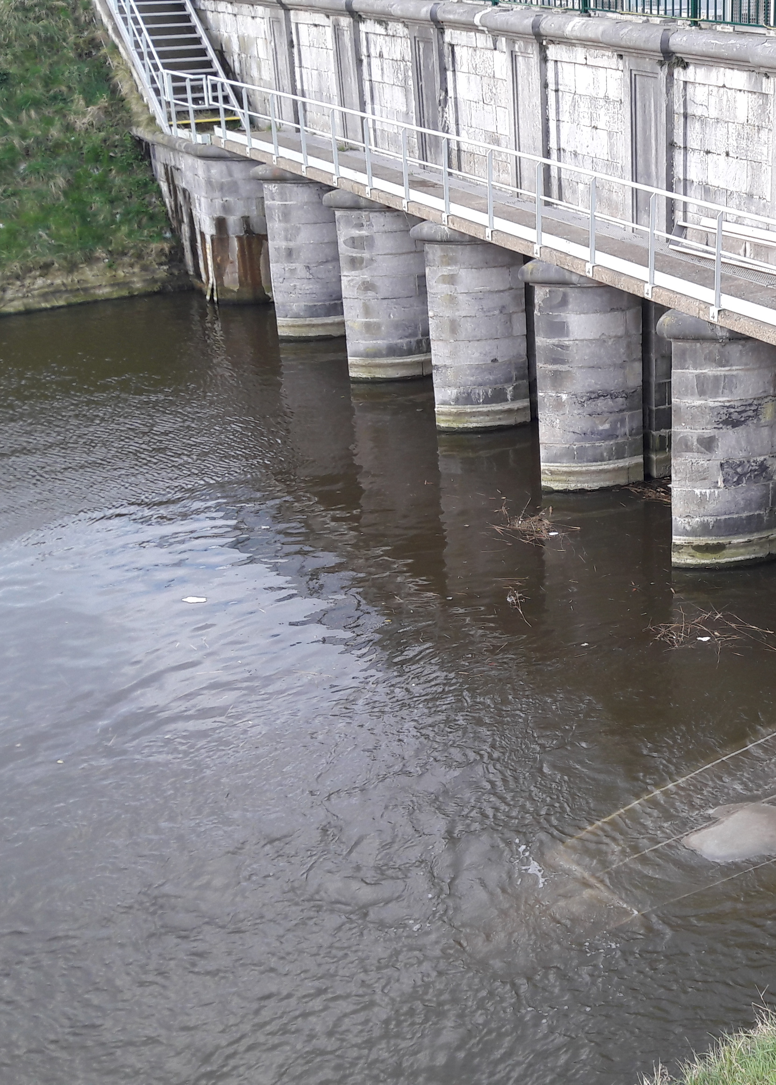
Content
Introduction
European eel – Life cycle
Natural habitat & current situation
Migration: dynamics & drivers
Fatty acids & fish
Objectives
Materials & methods
Study area
Sampling methods
Artificial substrates
Lift nets
Glass eel ladders
Parameters & Statistical analysis
Results
Diet
Artificial Substrates
Eel ladder
Fatty acid analysis
Discussion
Conclusion & take-home message

Slide 24
67,947 glass eel migrated through the V-A canal
Most were caught in the eel ladders (98,6%)
Eel conservation efforts in the V-A canal are important!
Biometrics
No lower threshold in condition factor found in settlers
In the artificial substrates, glass eels could increase their CF with ± 25%
Glass eel mortality in the canal?
FI increased faster in AS Migratory glass eels fed less
Lower FI at the pumping station Higher competition?
Different patterns in CF for AS & EL: increase in CF independent of diet quantity or resulting from individual variability in migratory capacity?

Slide 25
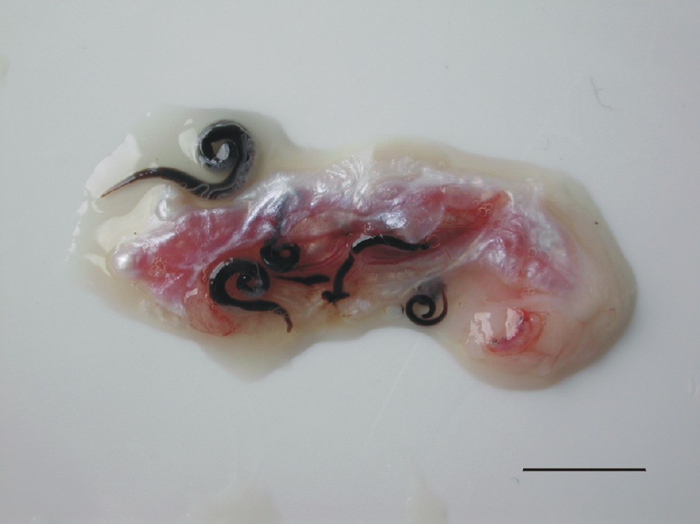
Diet
Most non-fed glass eels were found before 16/04/2017
Feeding started after this date (both in AS & EL)
The diet of EL glass eels contained relatively more cyclopoid copepods & Cladocera
The diet of AS glass eels contained relatively more harpacticoid copepods, polychaetes & amphipods
Copepods were the main dietary component Anguillicola crassus!
Glass eels are not exclusive benthic feeders

Slide 26
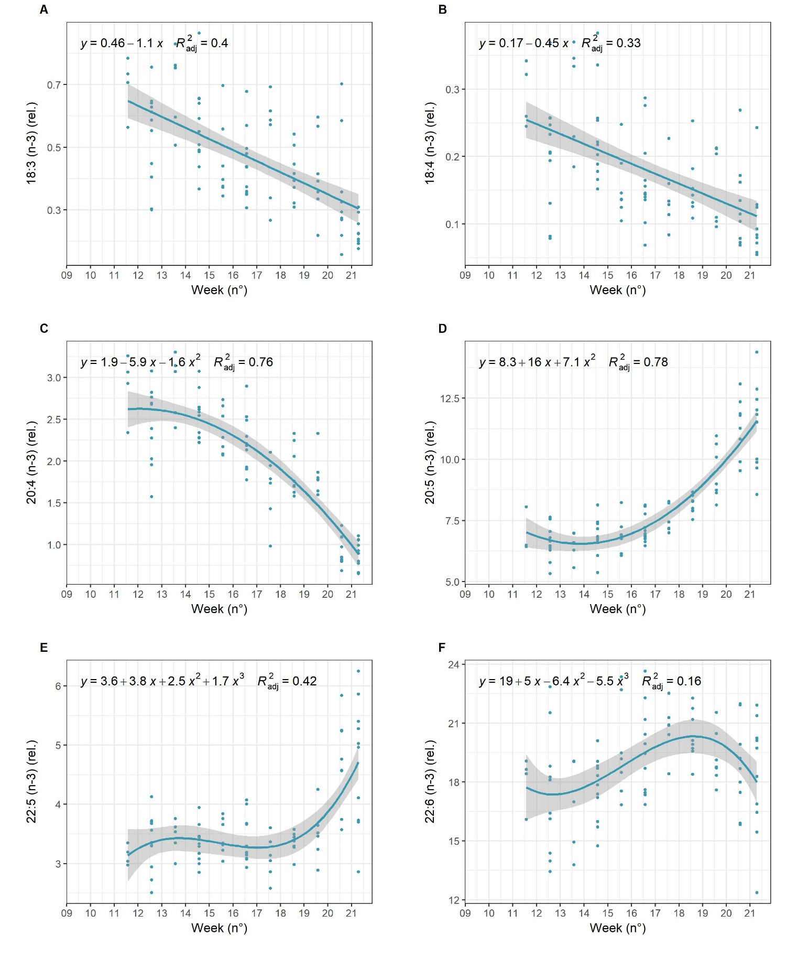
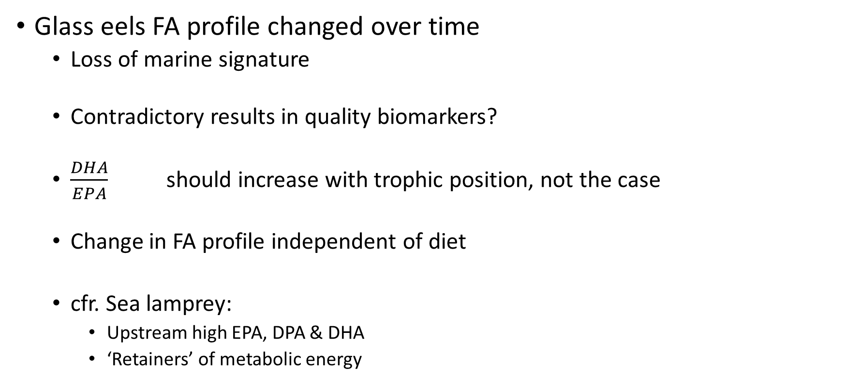
Glass eels FA profile changed over time
Loss of marine signature
Contradictory results in quality biomarkers?
$\frac{DHA}{EPA}$ should increase with trophic position, not the case
Change in FA profile independent of diet
cfr. Sea lamprey:
Upstream high EPA, DPA & DHA
‘Retainers’ of metabolic energy
Notes:
In the sea lamprey (Petromyzon marinus L.) spawning migration, the muscle fatty acid composition differed according to the location of capture, i.e. animals captured far upstream from the river mouth presented the lowest 18:1 (n-9) levels and the highest relative proportions of 20:4 (n-6), 20:5 (n-3) (EPA), 22:5 (n-3) (DPA) and 22:6 (n-3) (DHA). The researchers suggested that (I) the conservation of 20:4 (n-6) is vitally important as a precursor of eicosanoids; (II) EPA, DPA and DHA are retained for metabolic energy; and (III) 18:1 (n-9) is utilised for metabolic fuel in the beginning of the spawning period (Lança et al., 2011). Since the pattern observed from the glass eels starts from the opposite situation, and goes toward the sea lamprey fatty acid composition, it could be possible that the fatty acids in question serve the same purpose in the European eel. The onset of the increase in these fatty acids is already happening in the glass eel phase

Slide 27
Content
Introduction
European eel – Life cycle
Natural habitat & current situation
Migration: dynamics & drivers
Fatty acids & fish
Objectives
Materials & methods
Study area
Sampling methods
Artificial substrates
Lift nets
Glass eel ladders
Parameters & Statistical analysis
Results
Diet
Artificial Substrates
Eel ladder
Fatty acid analysis
Discussion
Conclusion & take-home message

Slide 28
Conclusion & take-home message
Substantial glass eel recruitment in the V-A canal
Glass eels do feed in the canal, increase in CF in settlers
CF not linked to fullness, probably role of dietary quality
Baseline study of FA profiles shifts in glass eel reveals interesting patterns, further research needed
Notes:
Take-home message:
Eel recruitment in the Veurne-Ambacht canal is substantial, and the largest fraction of the glass eel thrives to migrate further than the canal.
The populations caught with the different technniques differ in biometrical values,

Slide 29
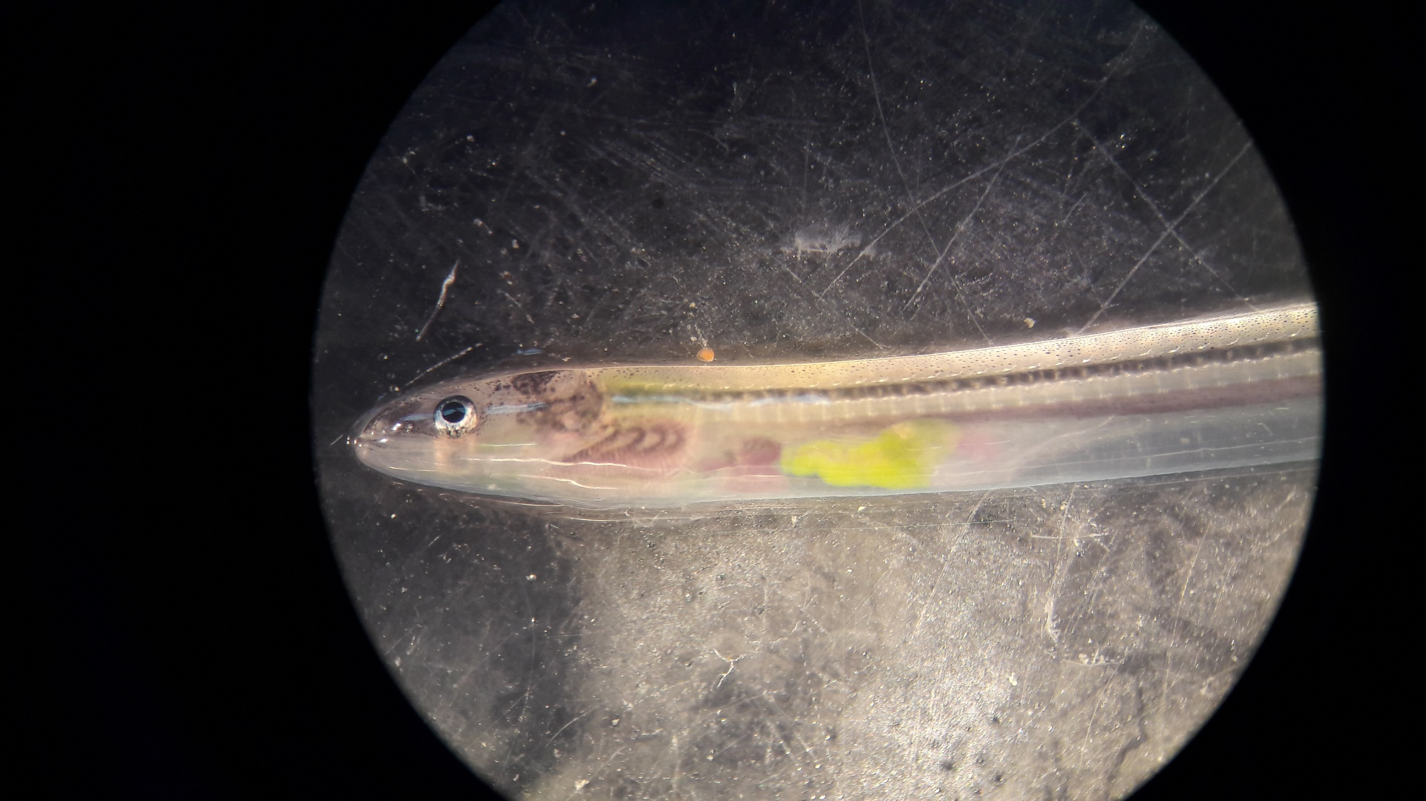
Acknowledgements
Thanks for your attention!
- Any questions?
Pieterjan Verhelst
Jeroen Van Wichelen
Marleen De Troch
Bruno Vlaeminck
Janne Simoens
And many many more!
Notes:
First and foremost, many thanks to my supervisor Dr. Pieterjan Verhelst for this opportunity. This thesis is only possible due to his superb guidance. Interesting discussions, fishing trips and other field work have proven to be valuable lessons. Thanks to Dr. Jeroen Van Wichelen for his assistance in determinations, interesting discussions on the topic and memorable nights at the Maertenssas. Thanks to prof. Dr. Marleen De Troch for her insightful guidance on the fatty acid analysis. Thanks to Bruno Vlaeminck for the assistance in fatty acid laboratory analysis. A sincere well deserved thank you to Janne Simoens for her great help with the practical lab work. A very loving thank you to Eline Lorer and Gillis Sanctobin for the mental support and writing marathon sessions. Thanks to Jens Boyen with the help on fatty acid statistical analyses in R. Thanks to Jens De Meyer for help with the glass eel head morphology analysis.

Slide 30
Date | Week
19/02/2017 – 25/02/2017 | 8
26/02/2017 – 04/03/2017 | 9
05/03/2017 – 11/03/2017 | 10
12/03/2017 – 18/03/2017 | 11
19/03/2017 – 25/03/2017 | 12
26/03/2017 – 01/04/2017 | 13
02/04/2017 – 08/04/2017 | 14
09/04/2017 – 15/04/2017 | 15
16/04/2017 – 22/04/2017 | 16
23/04/2017 – 29/04/2017 | 17
30/04/2017 – 06/05/2017 | 18
07/05/2017 – 13/05/2017 | 19
14/05/2017 – 20/05/2017 | 20
21/05/2017 – 27/05/2017 | 21

Slide 31
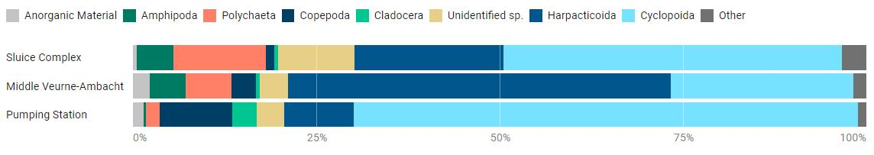
Notes:
Stomach and gut content according to location in the Veurne-Ambacht canal Amphipod crustaceans were not found in the guts and stomachs of glass eel in the artificial substrates near the pumping station, but were found in the guts and stomachs of glass eel from the artificial substrates at the Ganzepoot sluice complex and in the middle of the Veurne-Ambacht canal (4.9% in both) (Figure 12). Polychaetes were more present downstream of the canal (13% near the Ganzepoot sluices, 6% in the middle of the canal and 1.9% at the pumping station). Cladocera were more abundant in stomachs and guts of glass eel from the pumping station artificial substrates. Harpacticoid copepods were most abundant in the guts and stomachs of glass eel from the middle of the canal (52%). Cyclopoid copepods were most abundant in stomachs and guts of glass eel from the pumping station artificial substrates (69%), whereas they were part of 46% of the stomach and gut contents of glass eel sampled at the Ganzepoot sluices, and 25% of the stomach and gut contents in the middle of the canal.

Slide 32
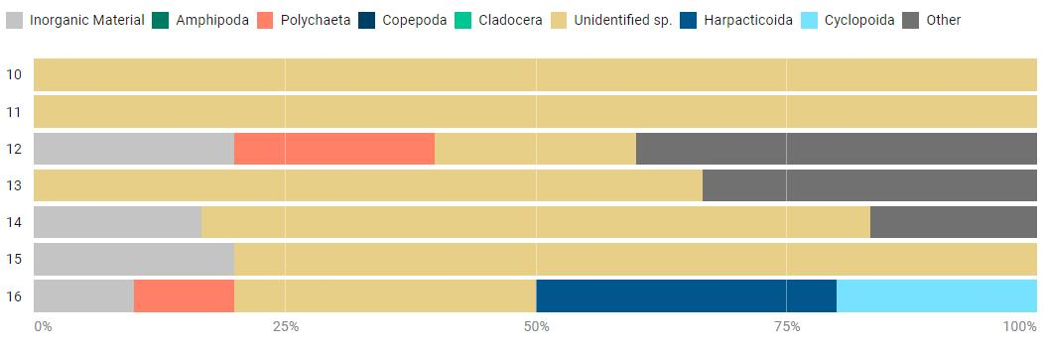
Notes:
Stomach and gut content in the lift nets
In week 10, 11, 13, 14 and 15 glass eel caught using lift nets have mostly empty guts and stomachs, apart from inorganic material (Figure 14). In week 12 and 16 polychaetes are found, harpacticoid and cyclopoid copepods were found in week 16 only.

Slide 33
Notes:
Figure 9 Condition factor over time, per method

Slide 34
Notes:
Polynomial regressions on the relation between FI and time. Red dots indicate an empty glass eel stomach, black dots indicate stomach was not empty

Slide 35
Notes:
Univariate regression analysis of glass eel sampled at the artificial substrates. (A) Linear regression analysis on total absolute (mg FA / g dry weight) fatty acid values over time.( B) Polynomial regression on biomarker ratio DHA/EPA over time, based on relative fatty acid frequencies. (C) Linear regression analysis on biomarker ratio PUFA/(SFA + MUFA over time, based on relative fatty acid frequencies). (D) Regression analysis on biomarker ratio EPA/AA over time, based on relative fatty acid frequencies. (E) Linear regression analysis of biomarker ratio n-3/n-6 over time, based on relative fatty acid frequencies.

Slide 36
Notes:
Regression analysis on the omega-3 relative fatty acid concentrations over time in glass eel sampled with artificial substrates in the Veurne-Ambacht canal

Slide 37
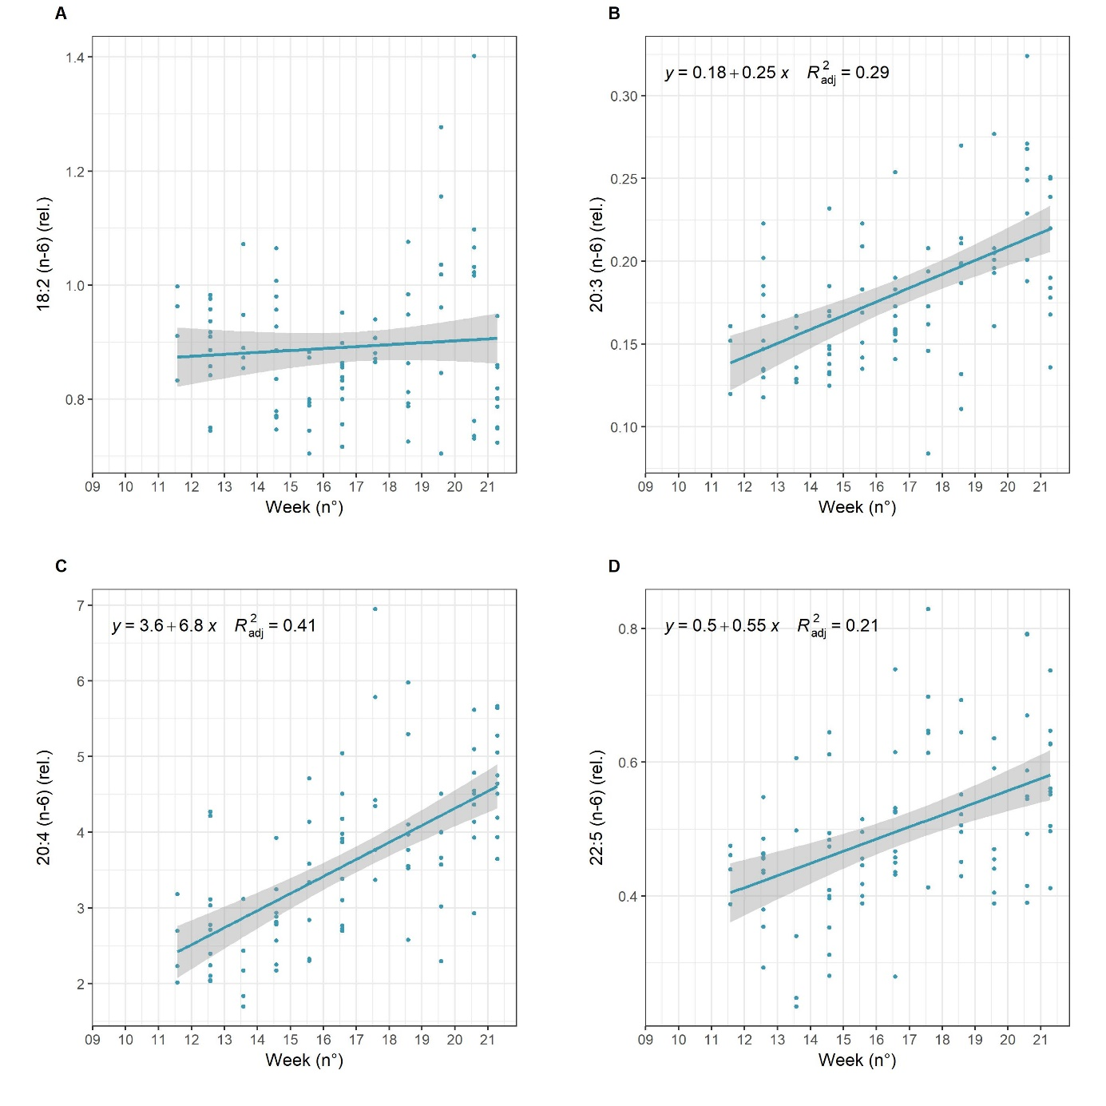
Notes:
Regression on relative omega 6 fatty acid concentrations of glass eel sampled in artificial substrates in the Veurne-Ambacht canal

Slide 38
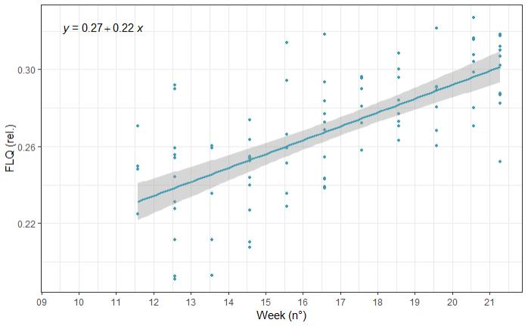
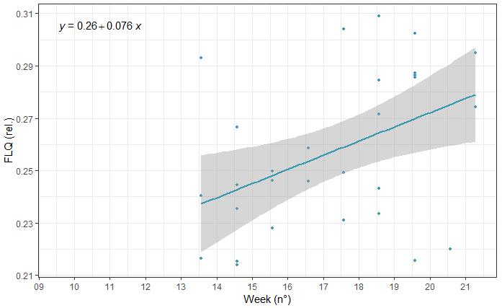
Notes:
Fish Lipid Quality over time in the artificial substrates (left) and eel ladder (right)

Slide 39
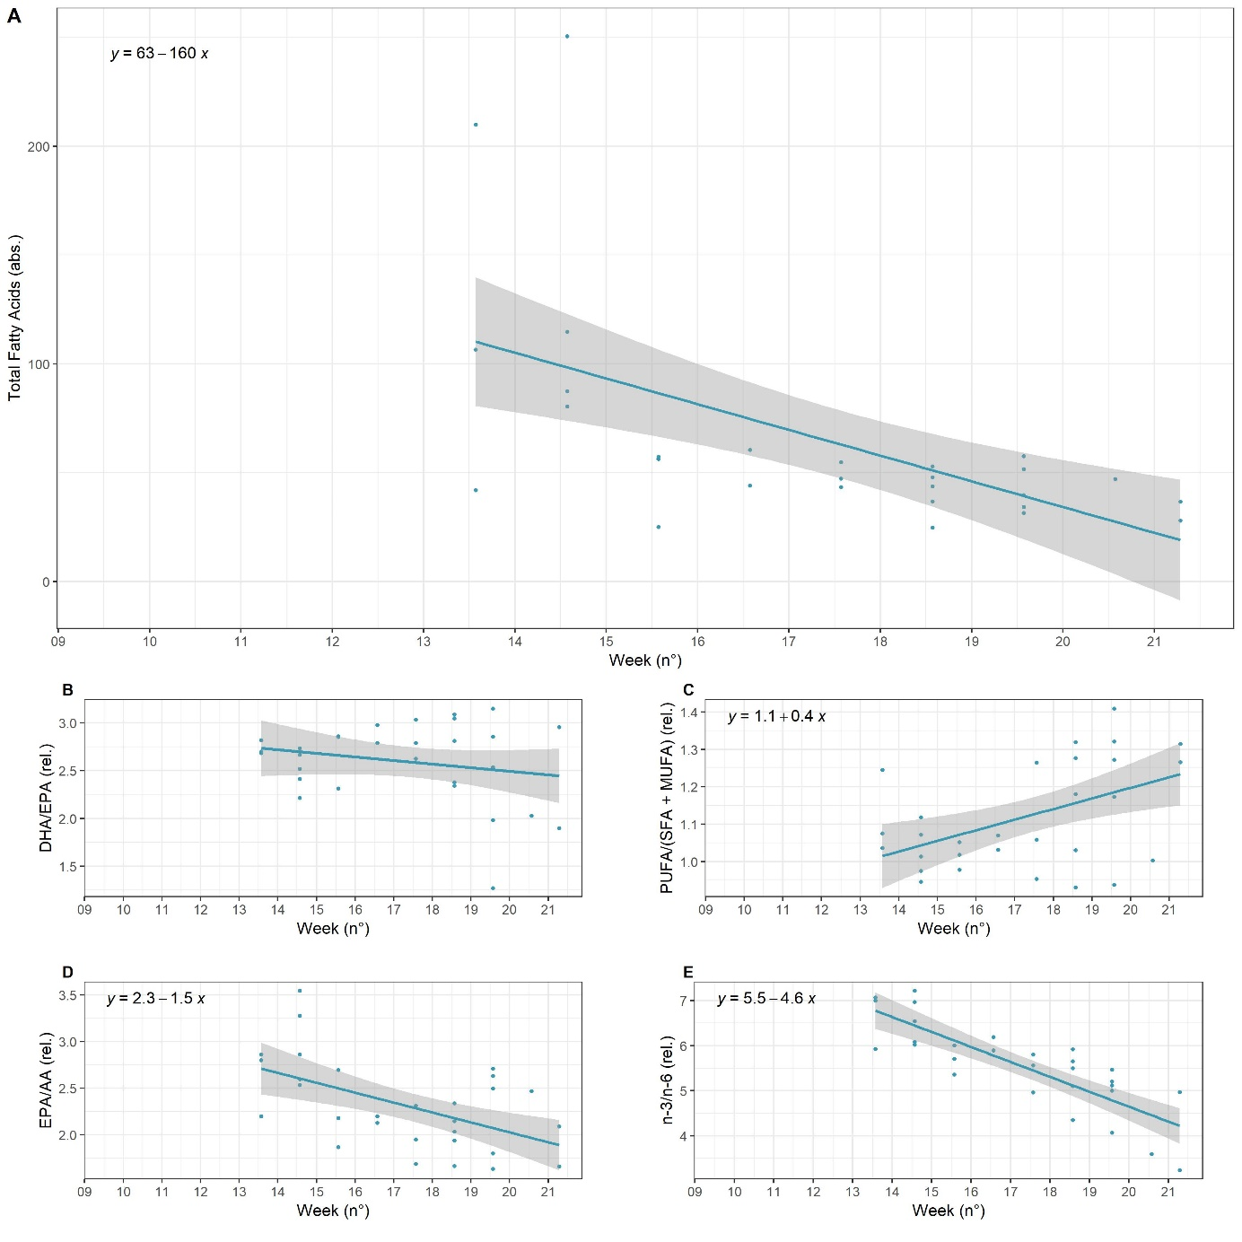
Notes:
Univariate regression analysis of glass eel sampled in the eel ladders. (A) Linear regression analysis on total absolute (mg FA / g dry weight) fatty acid values over time.( B) Polynomial regression on biomarker ratio DHA/EPA over time, based on relative fatty acid frequencies. (C) Linear regression analysis on biomarker ratio PUFA/(SFA + MUFA over time, based on relative fatty acid frequencies). (D) Regression analysis on biomarker ratio EPA/AA over time, based on relative fatty acid frequencies. (E) Linear regression analysis of biomarker ratio n-3/n-6 over time, based on relative fatty acid frequencies

